Slide 1
Women, Gender & Development 1980-2015
Fotocaroussel Ireen Dubel tgv receptie seminar 25 september 2015, deel 1

Slide 2
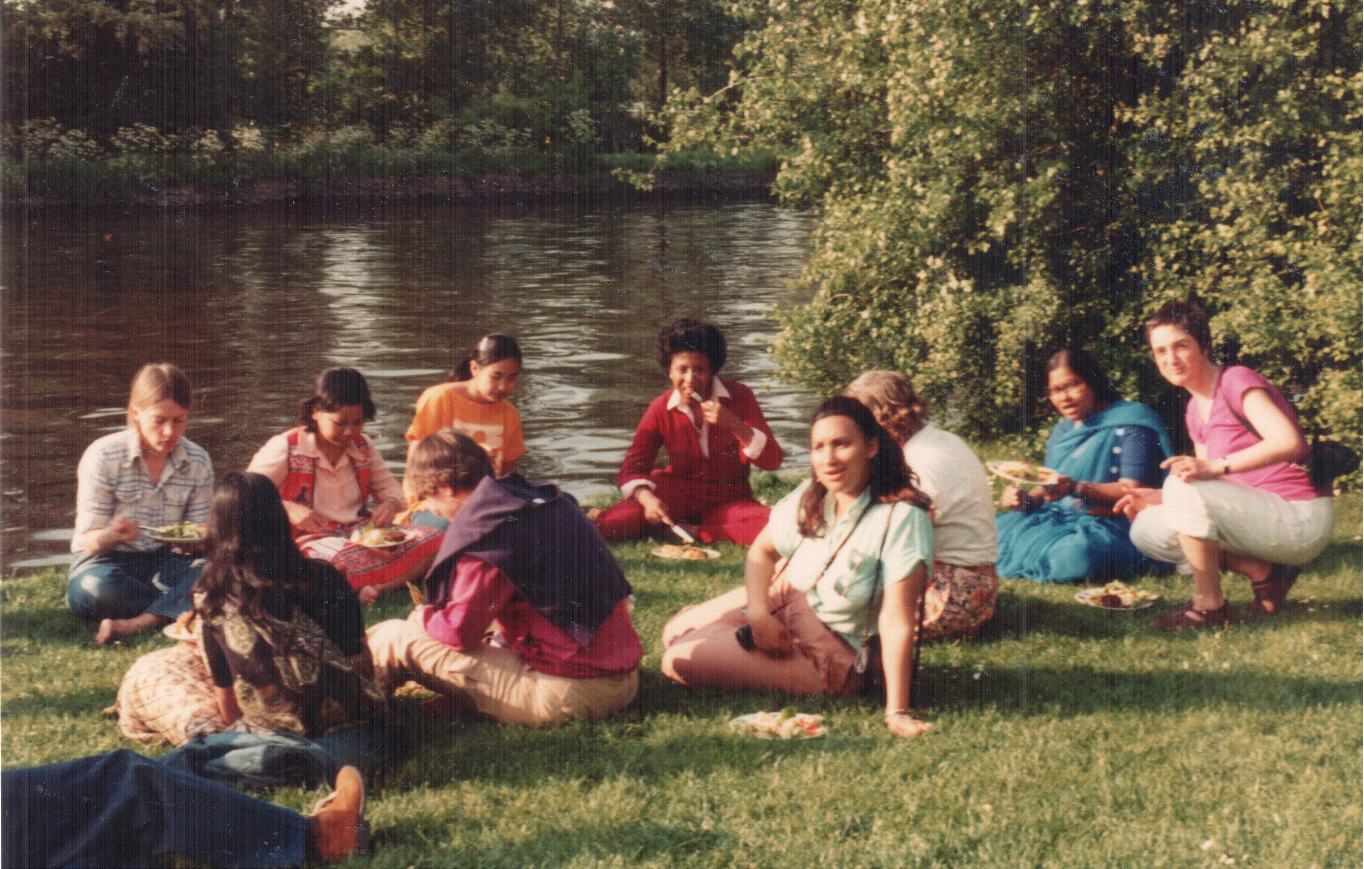
ISS Women and Development class 1980 - 1981

Slide 3
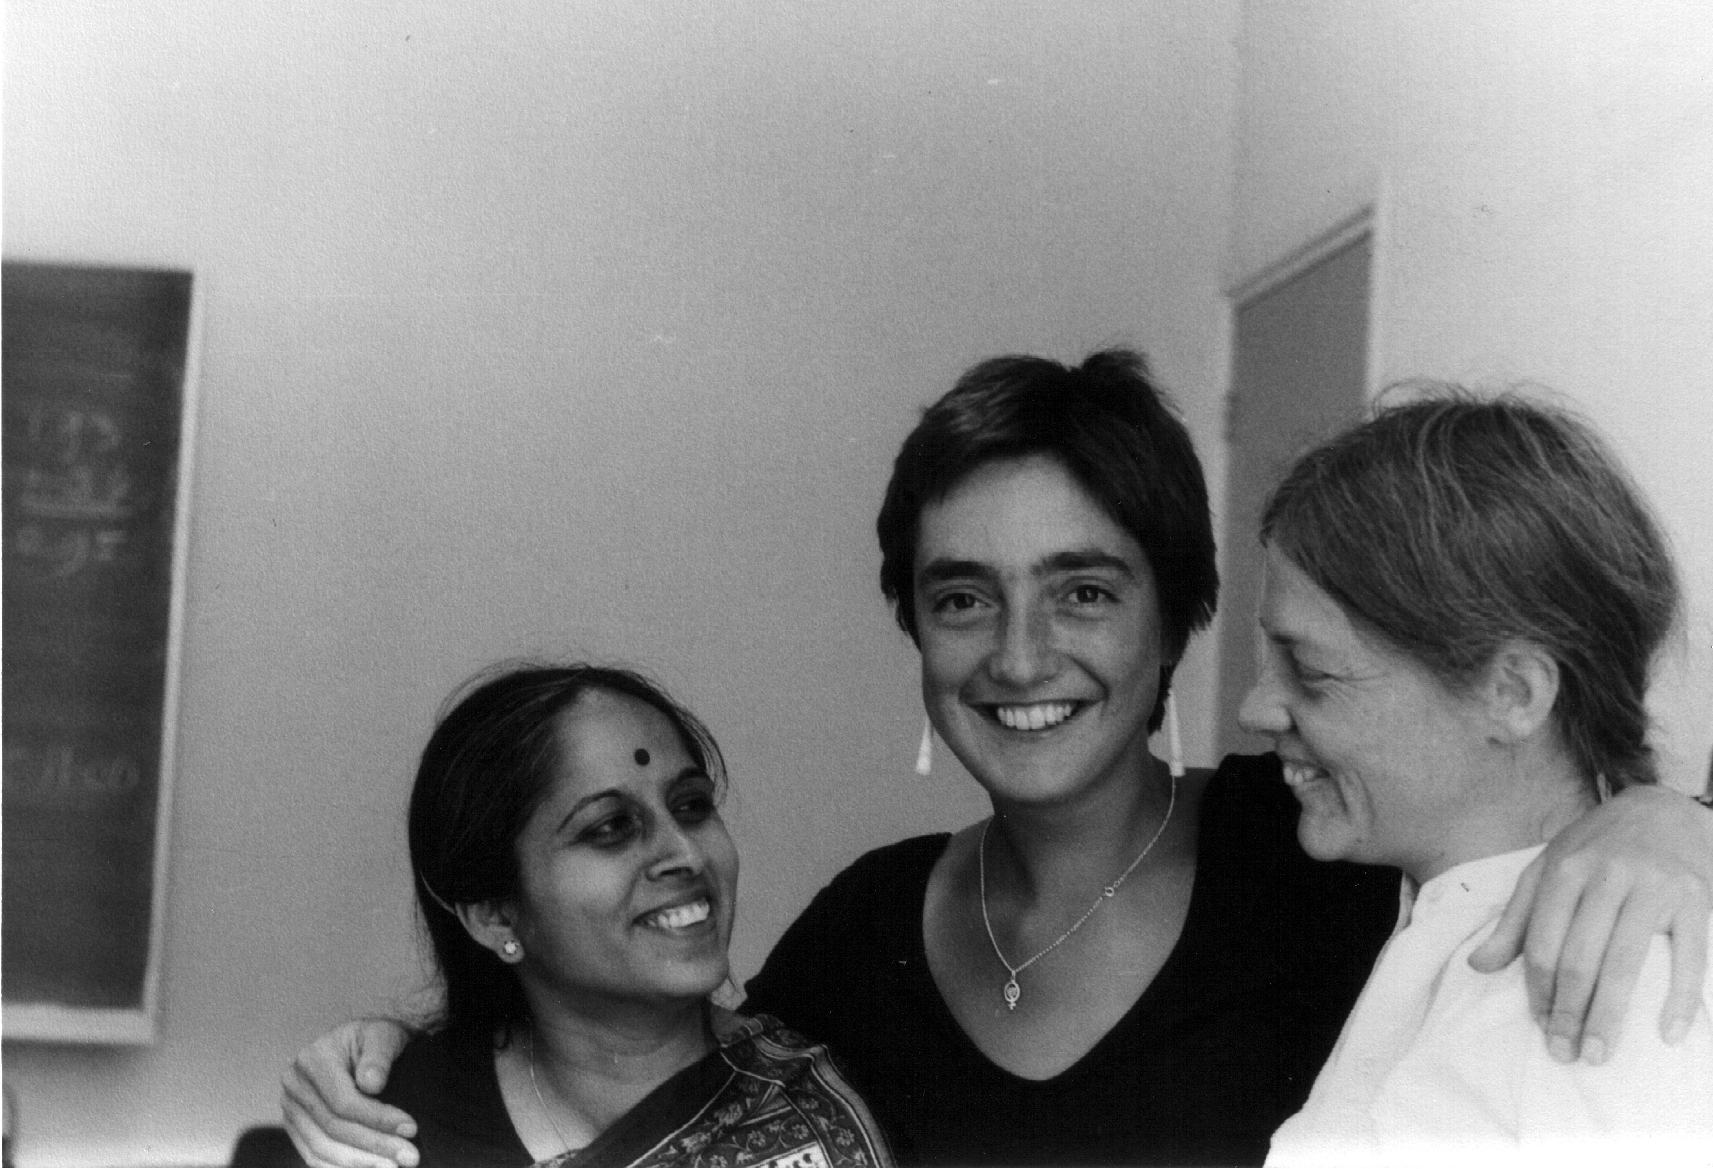
ISS Women’s Movements Research Project 1983

Slide 4
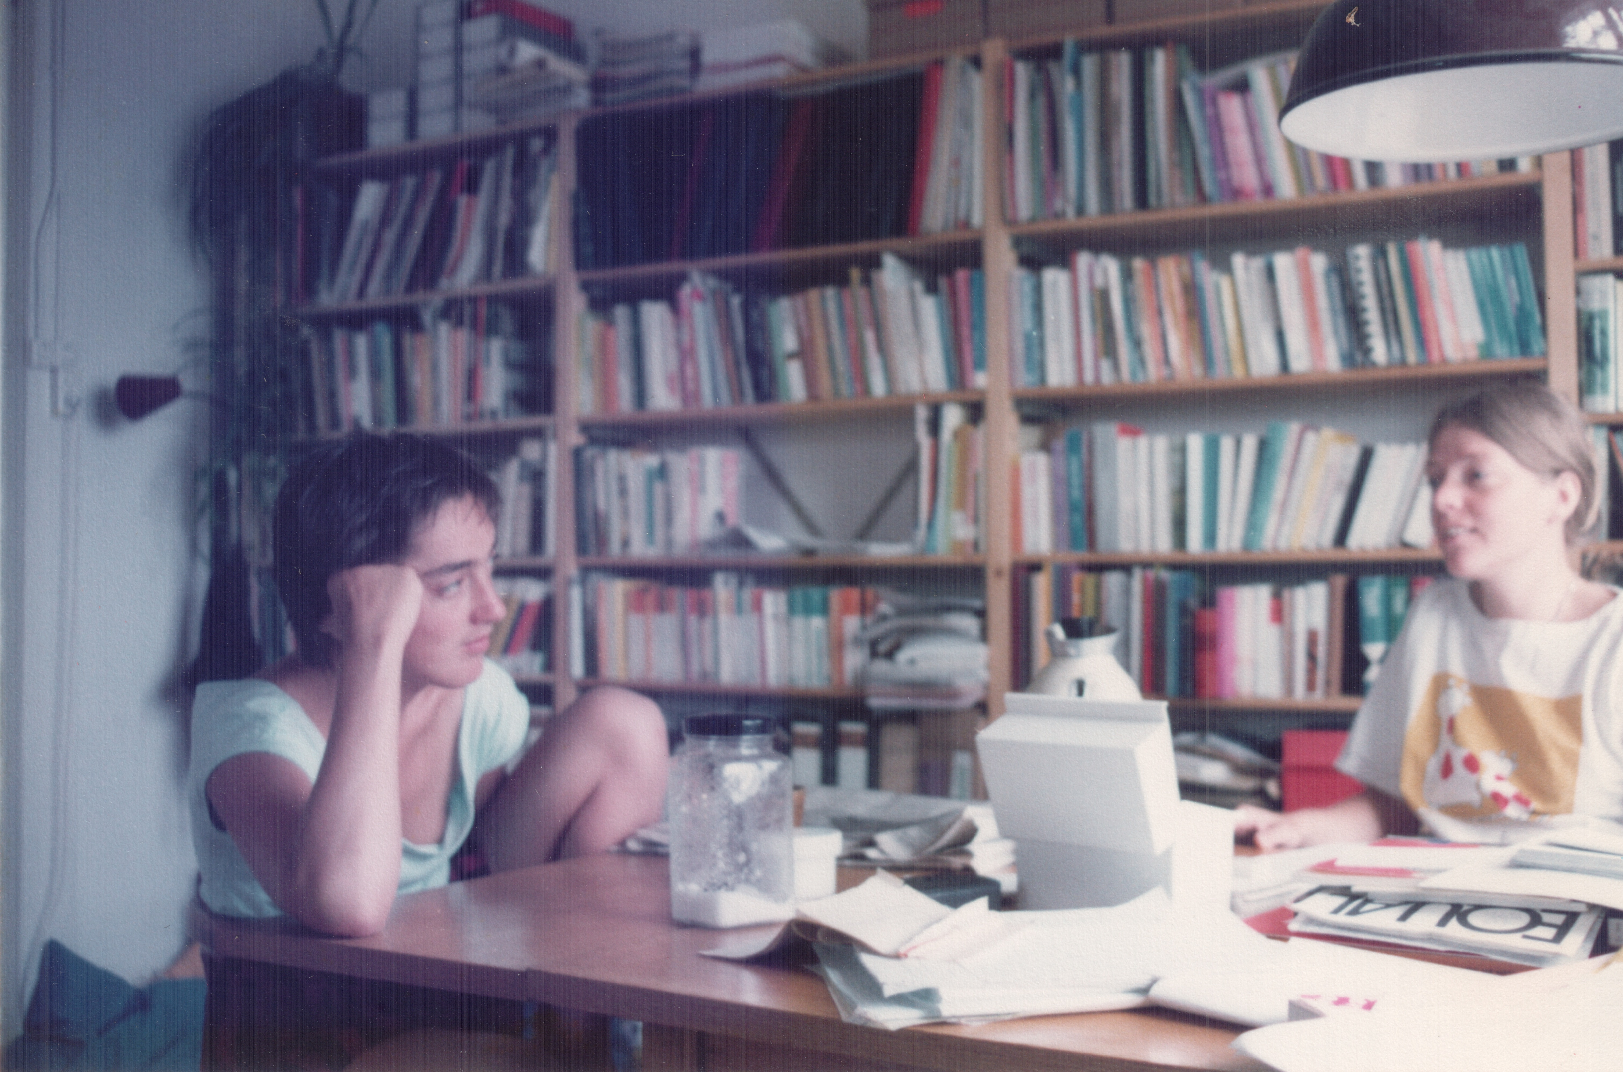
Thesis discussion Amsterdam 1983

Slide 5
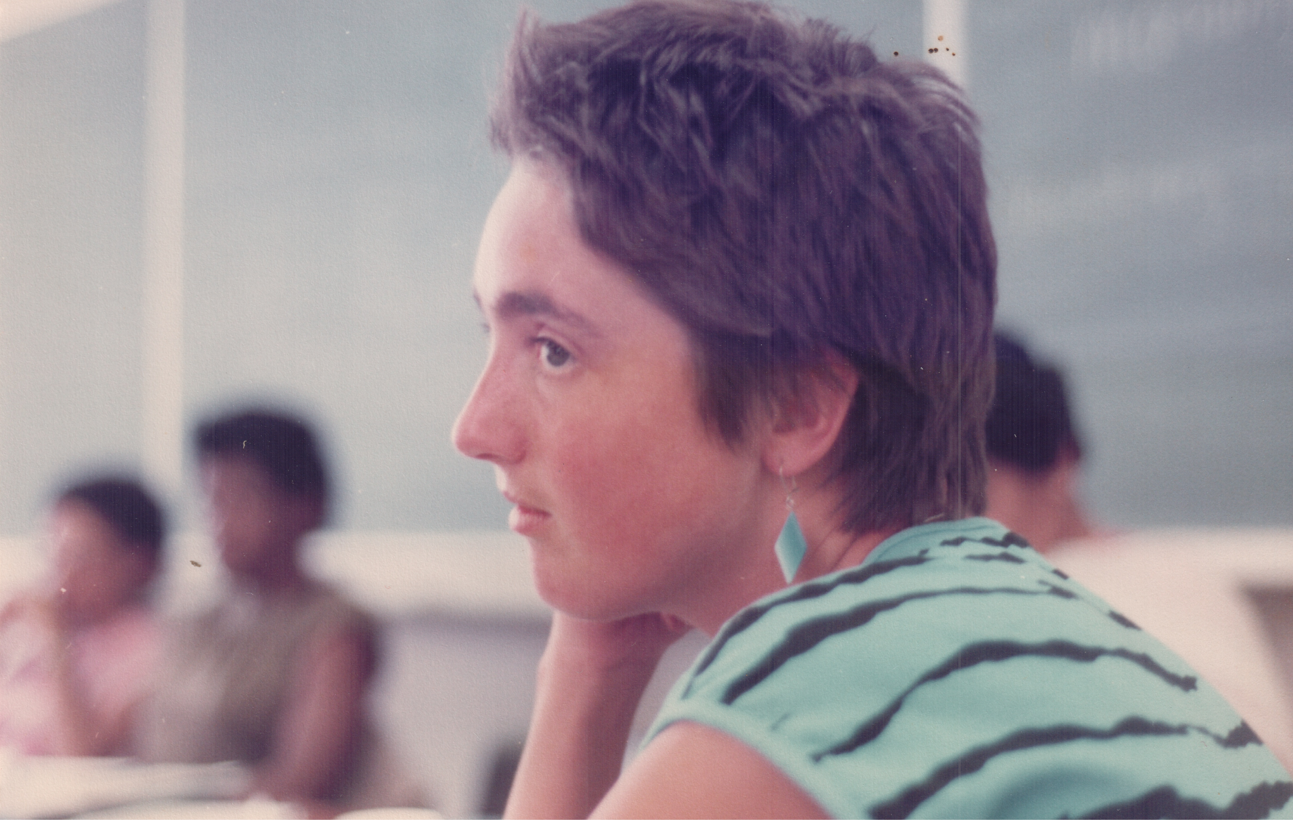
ISS Women’s Movements Research Project 1983

Slide 6
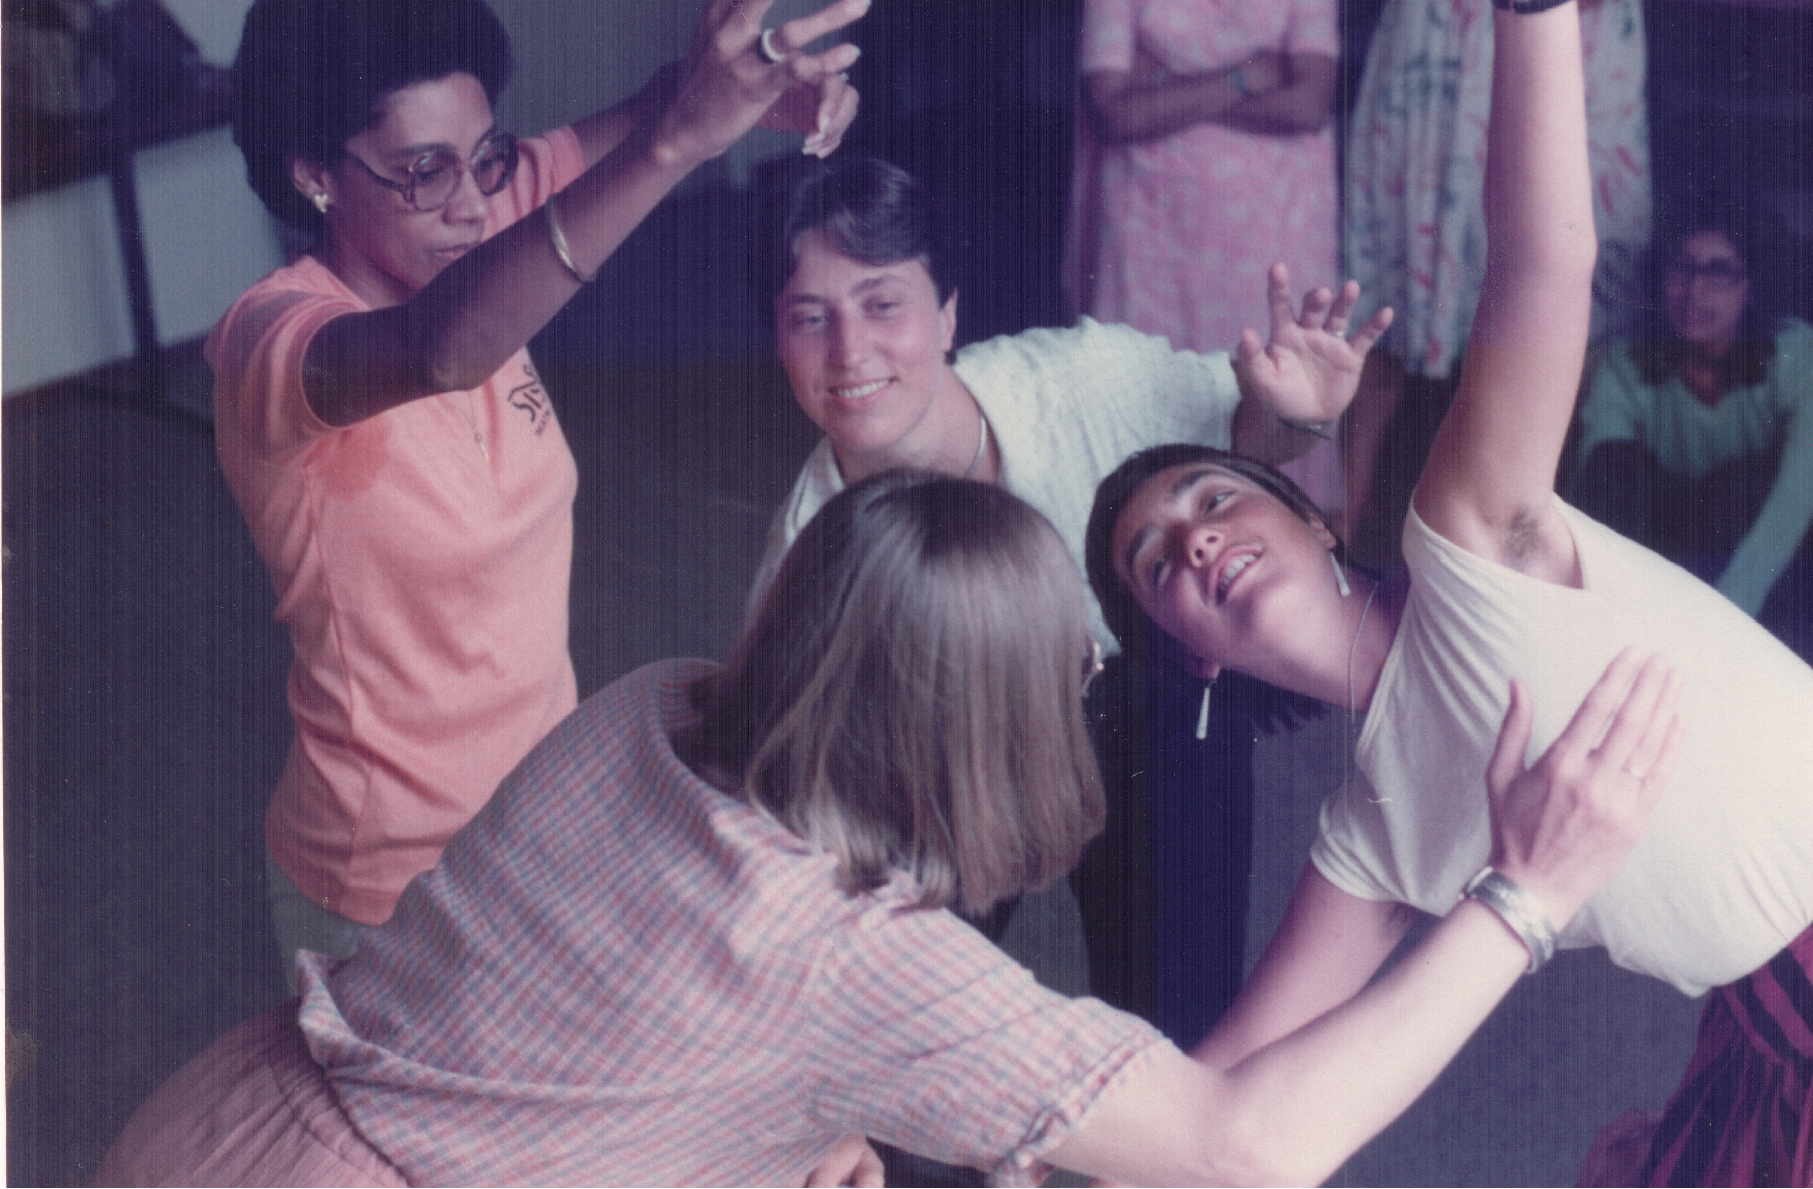
ISS Women’s Movements Research Project 1983

Slide 7
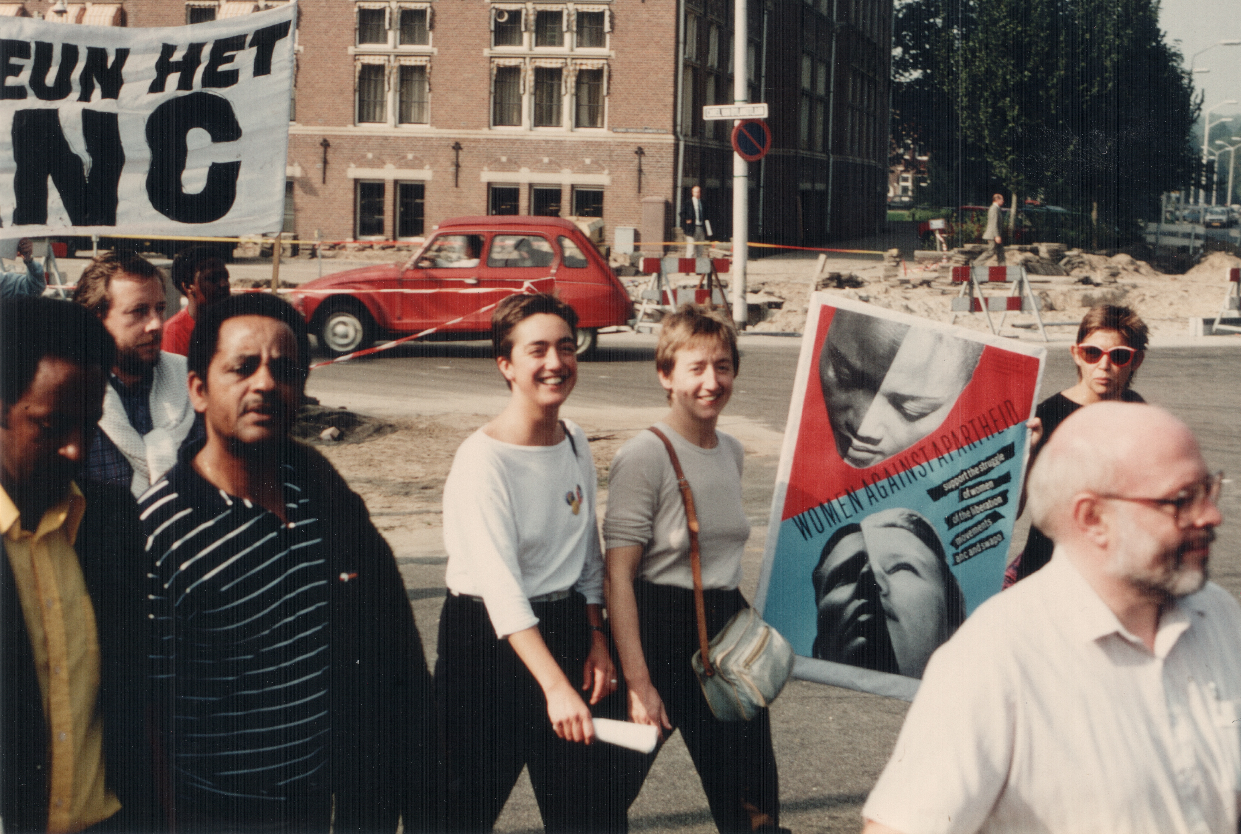
Anti-apartheid demonstration The Hague 1985

Slide 8
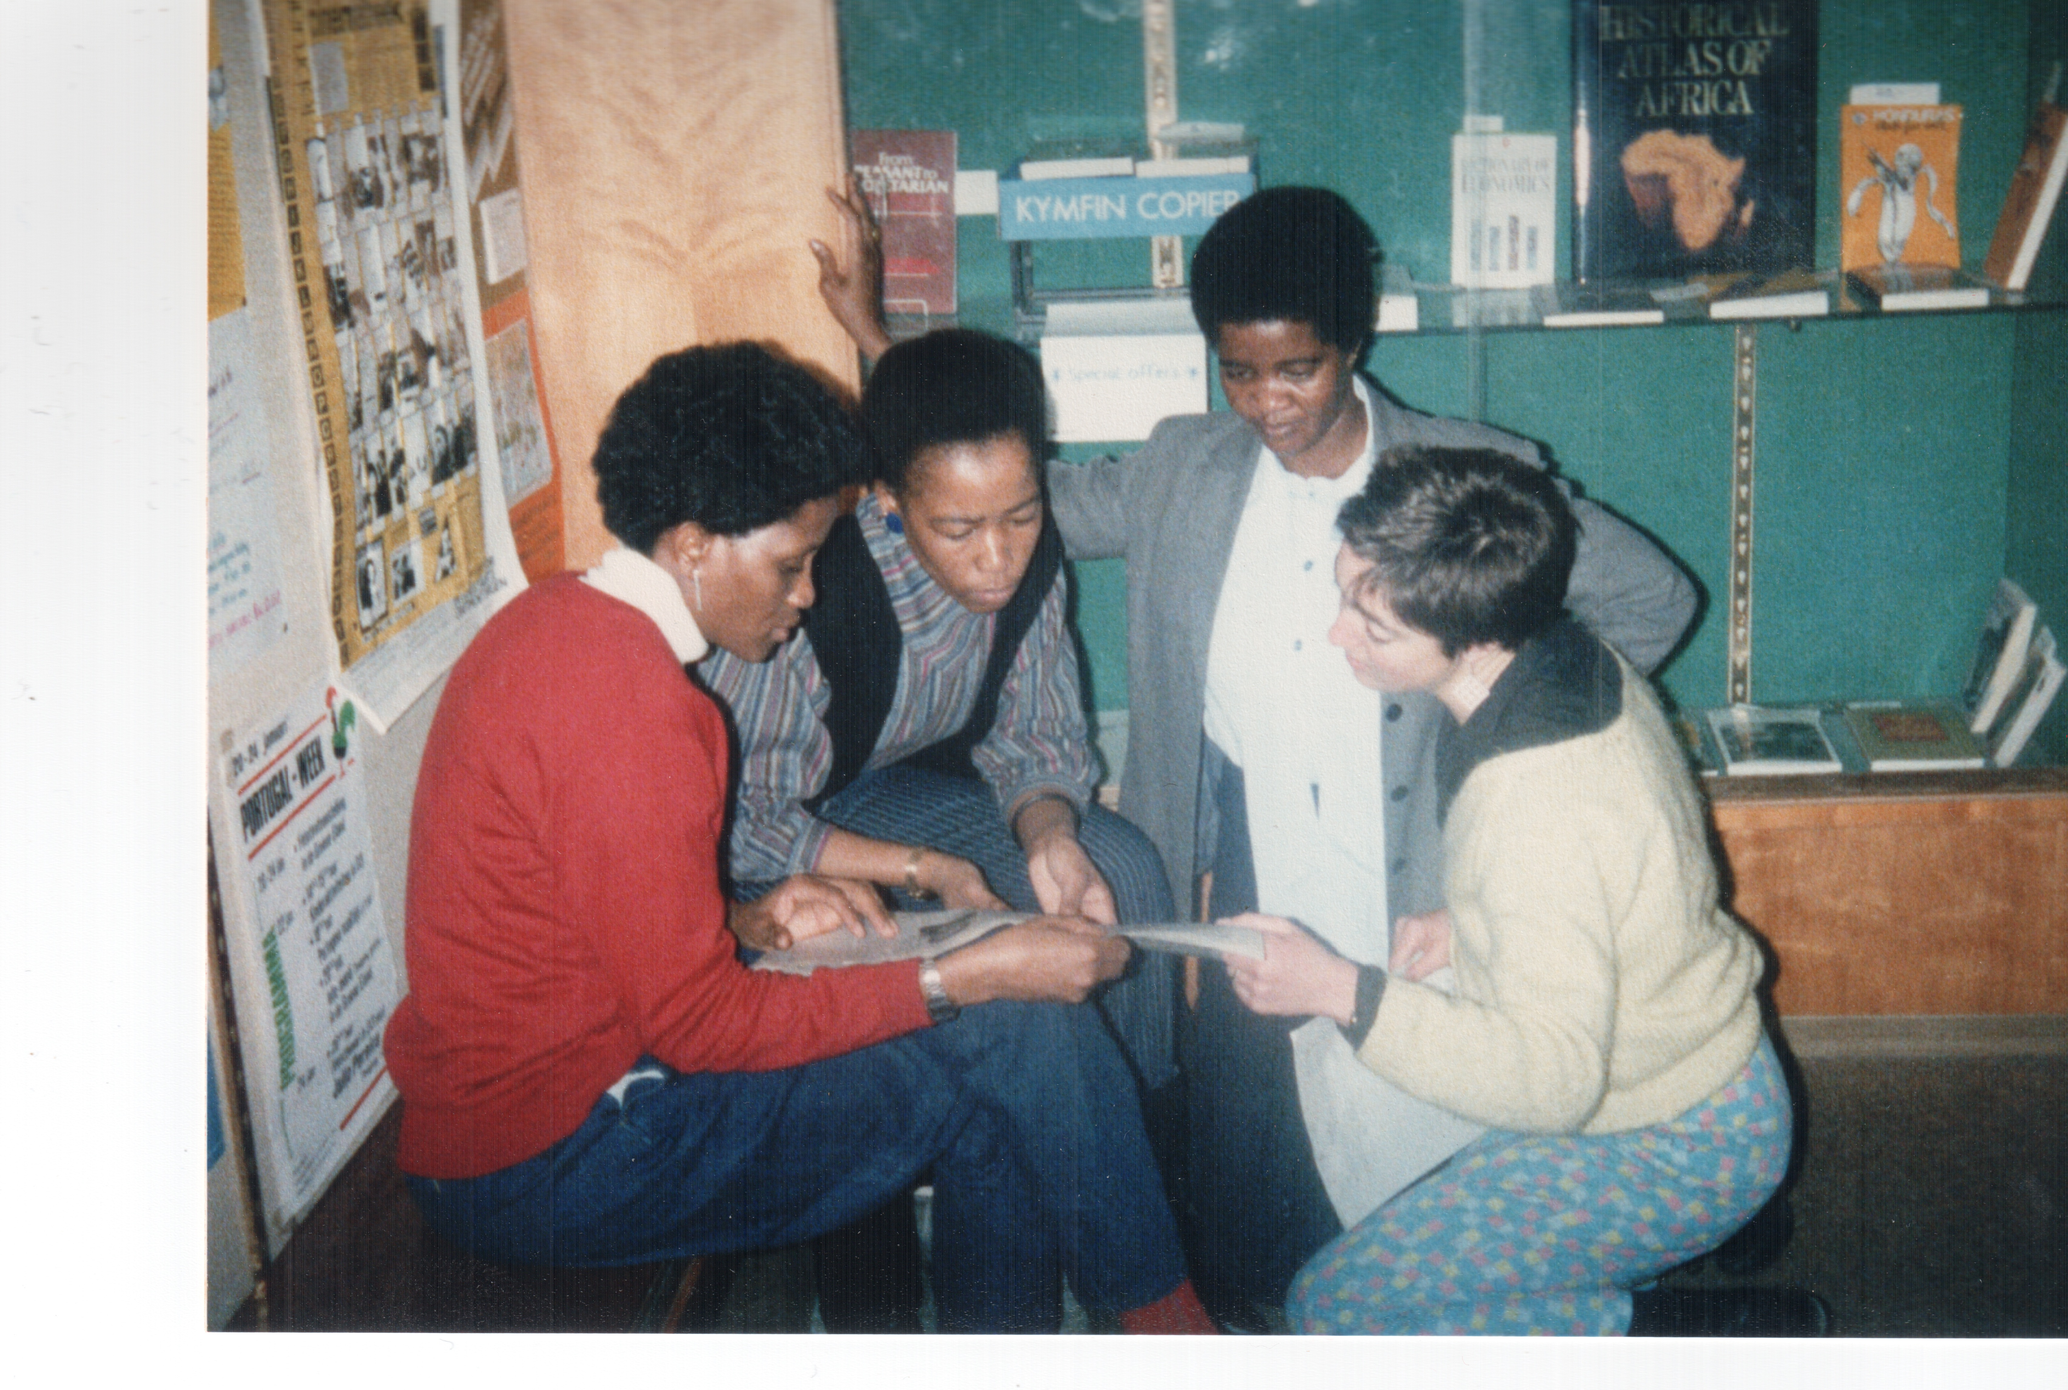
ISS SWAPO Women & Developent Diploma Programme 1985

Slide 9
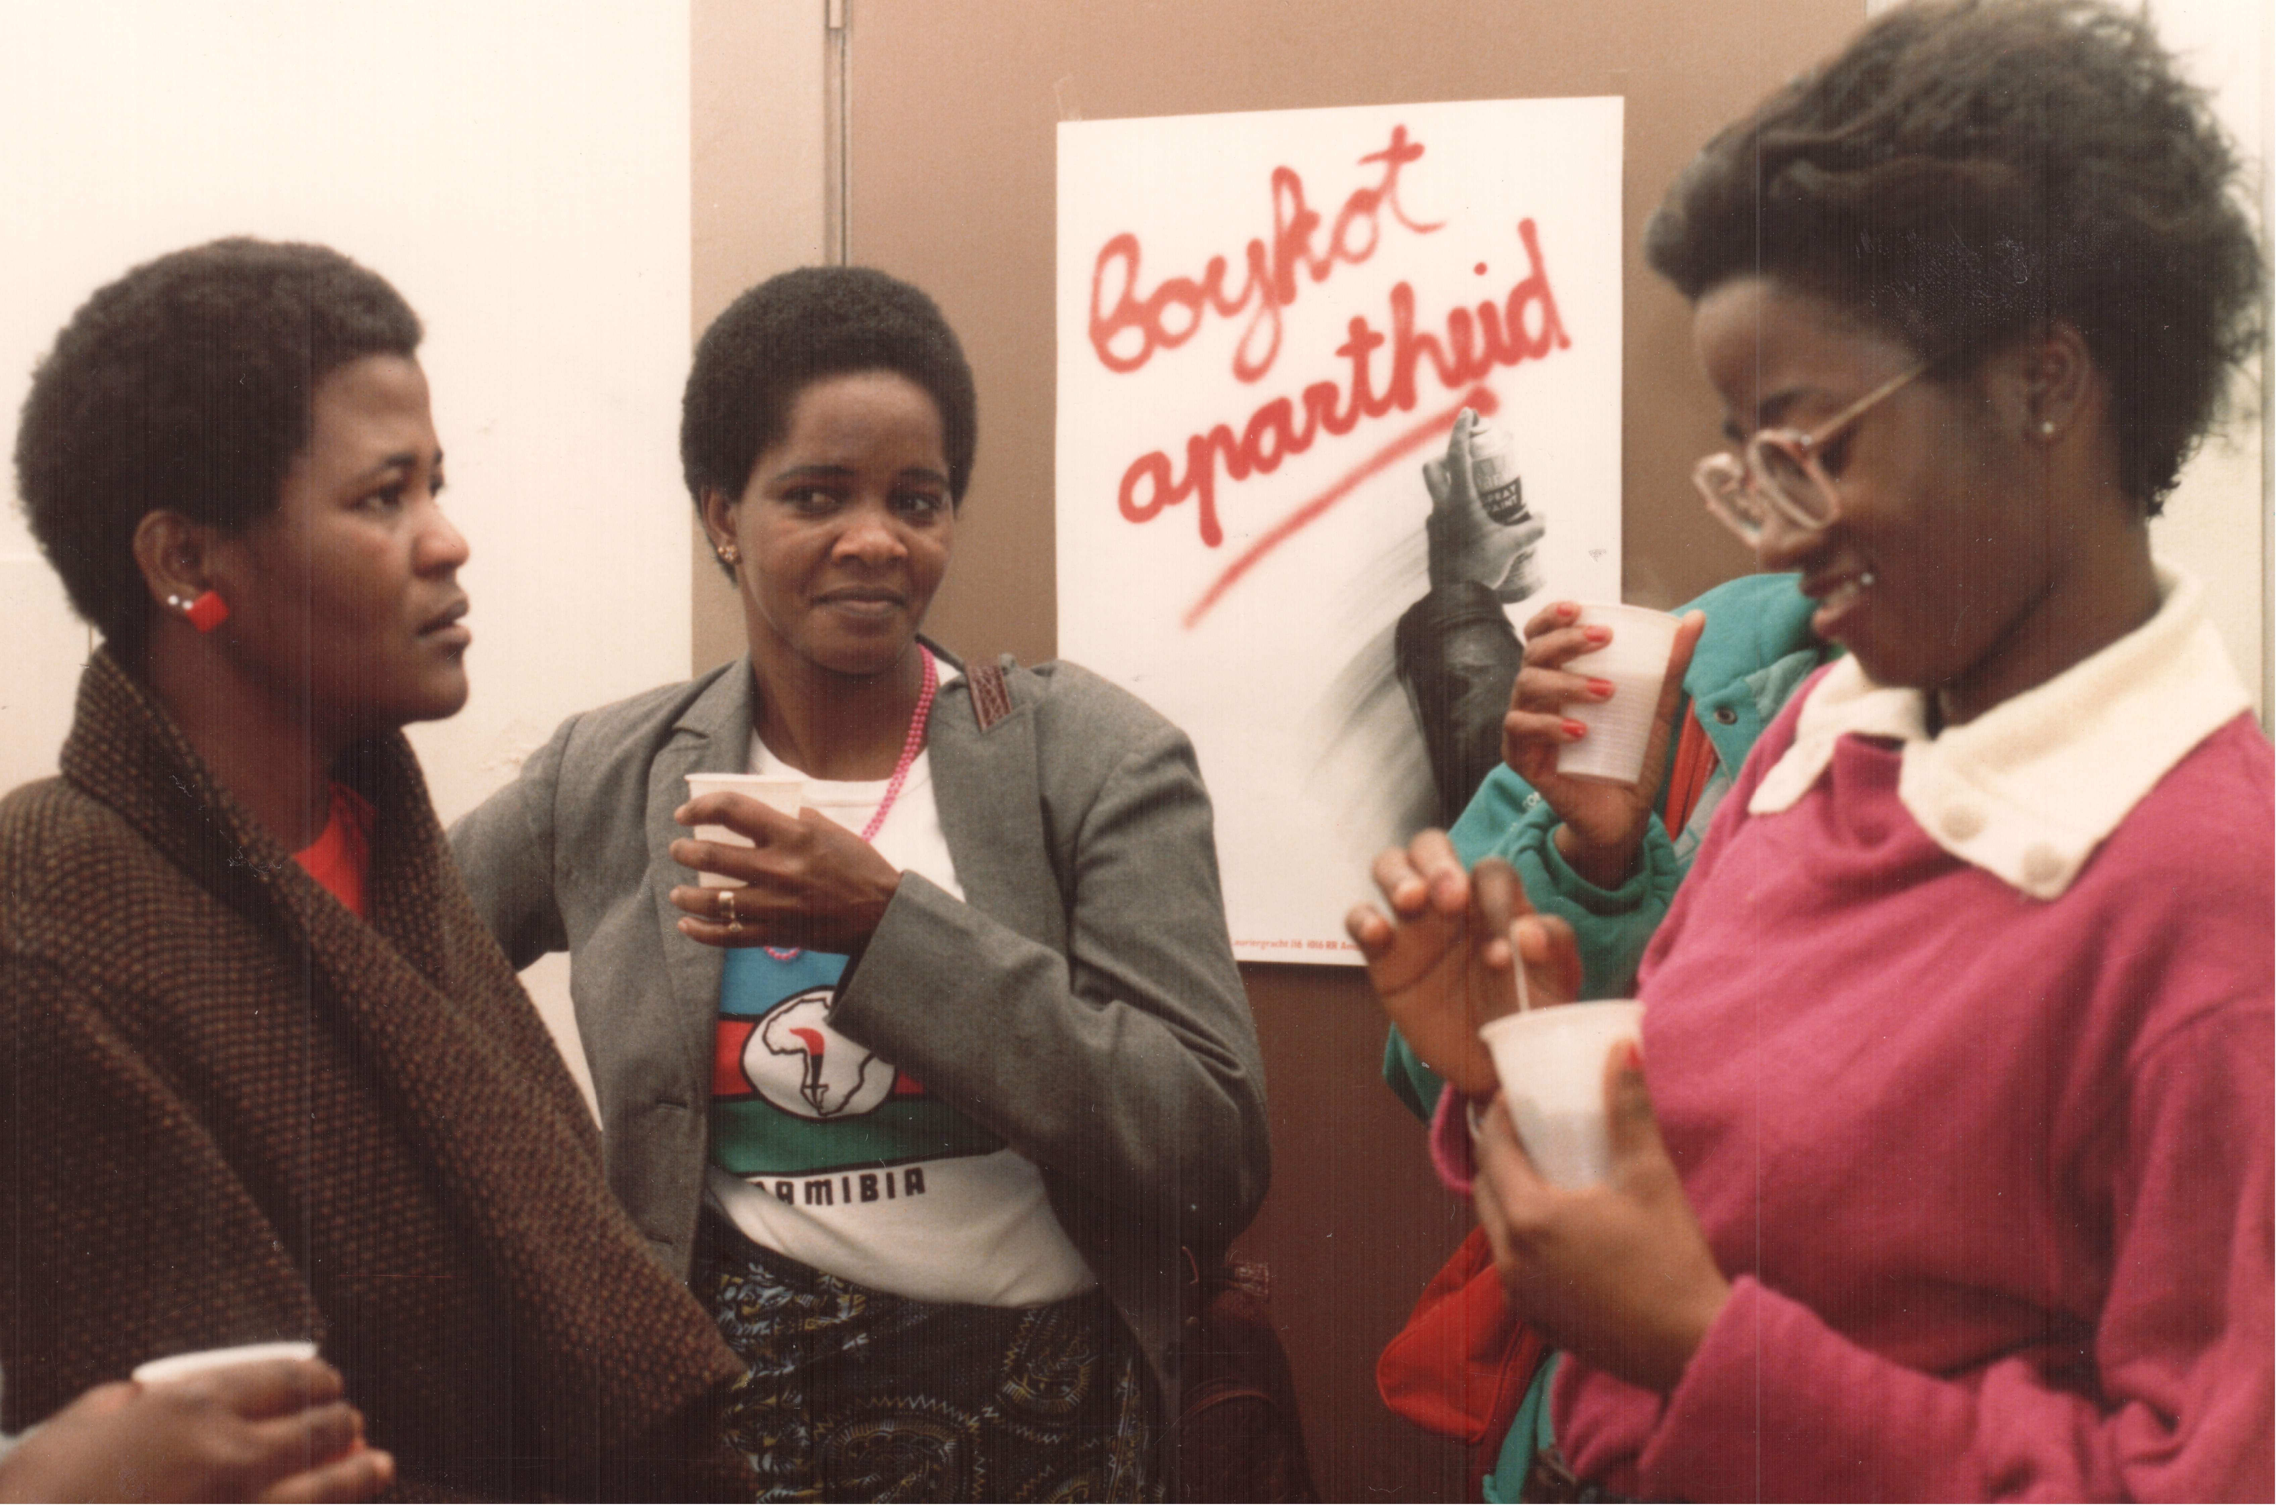
ISS students at Namibian Women’s Day Amsterdam 1985

Slide 10
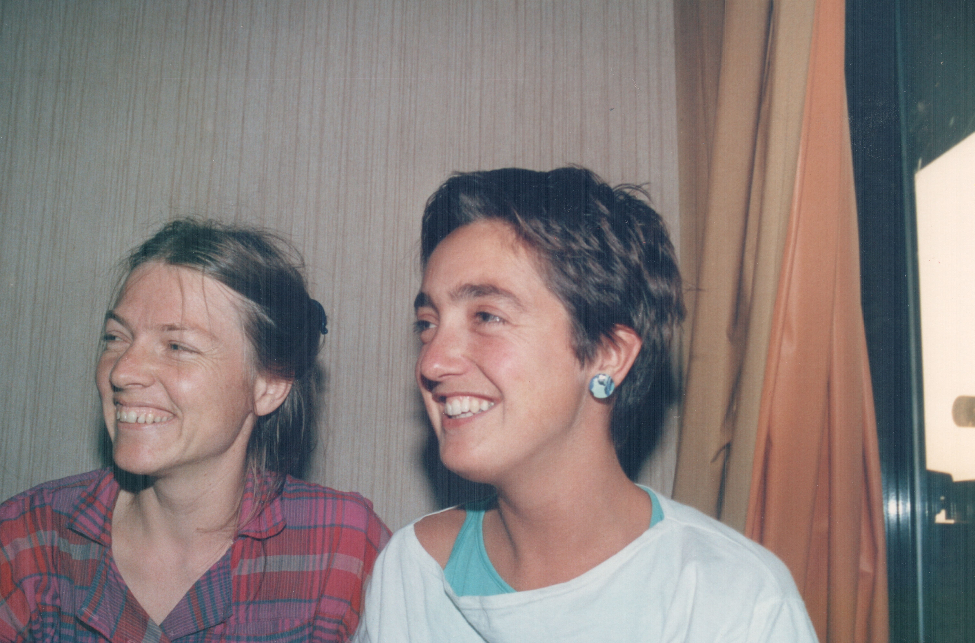
ISS Women’s Movements Research Project 1985

Slide 11
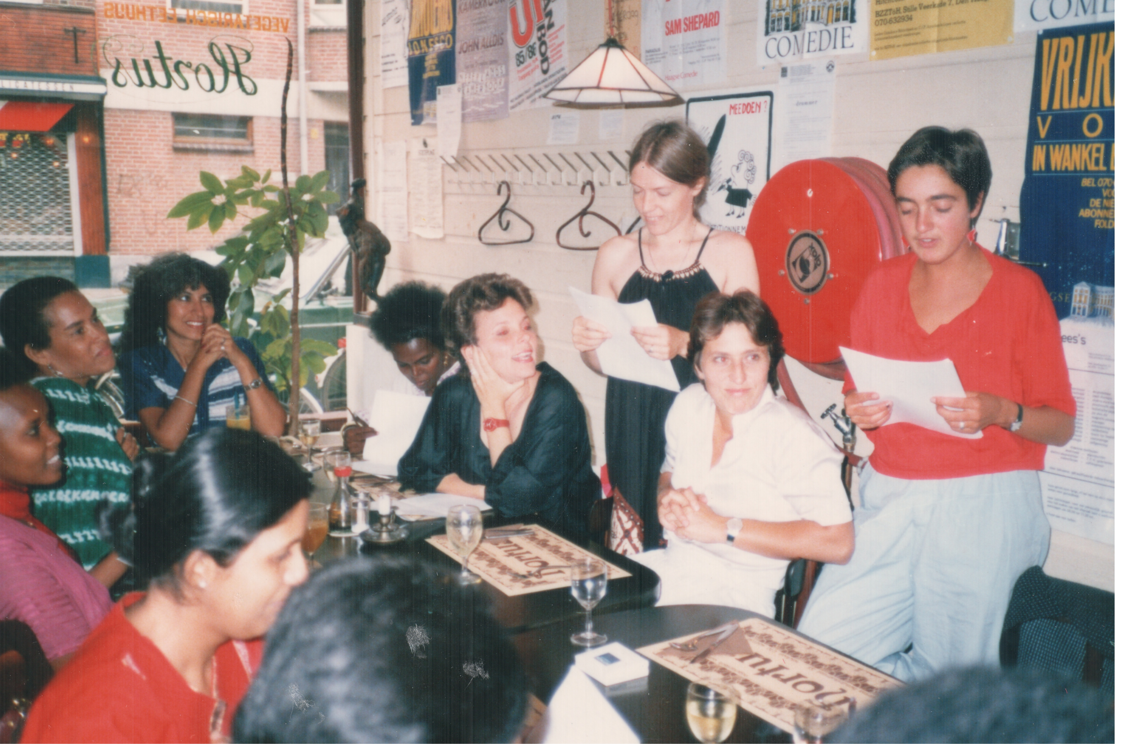
ISS Women’s Movements Research Project 1985

Slide 12
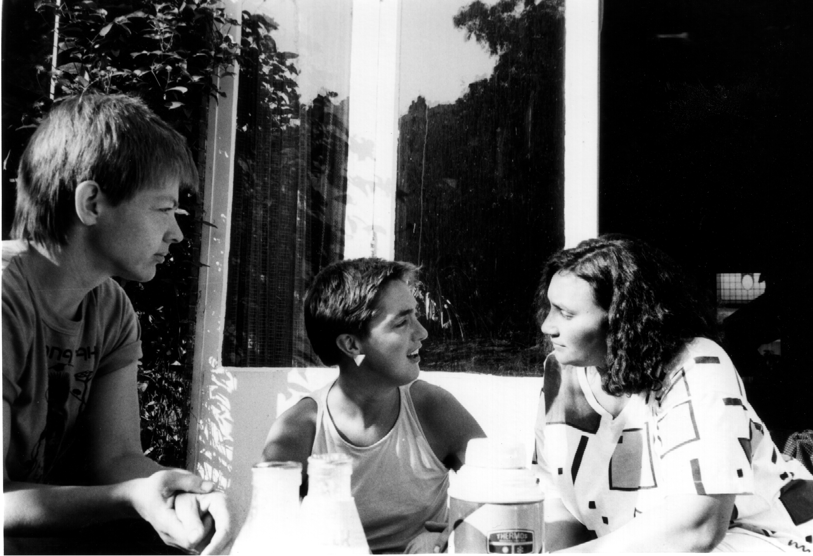
South African Women’s Day preparations The Hague 1986

Slide 13
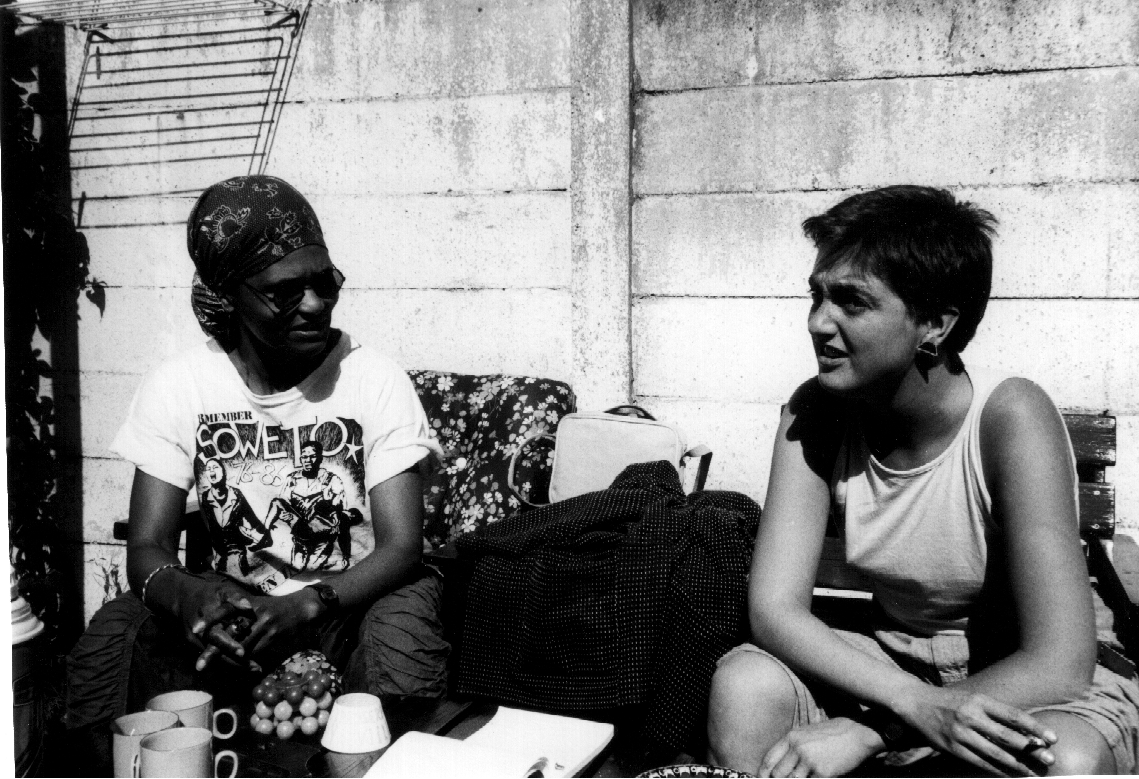
South African Women’s Day preparations The Hague 1986

Slide 14
South African Women’s Day Amsterdam 1986

Slide 15
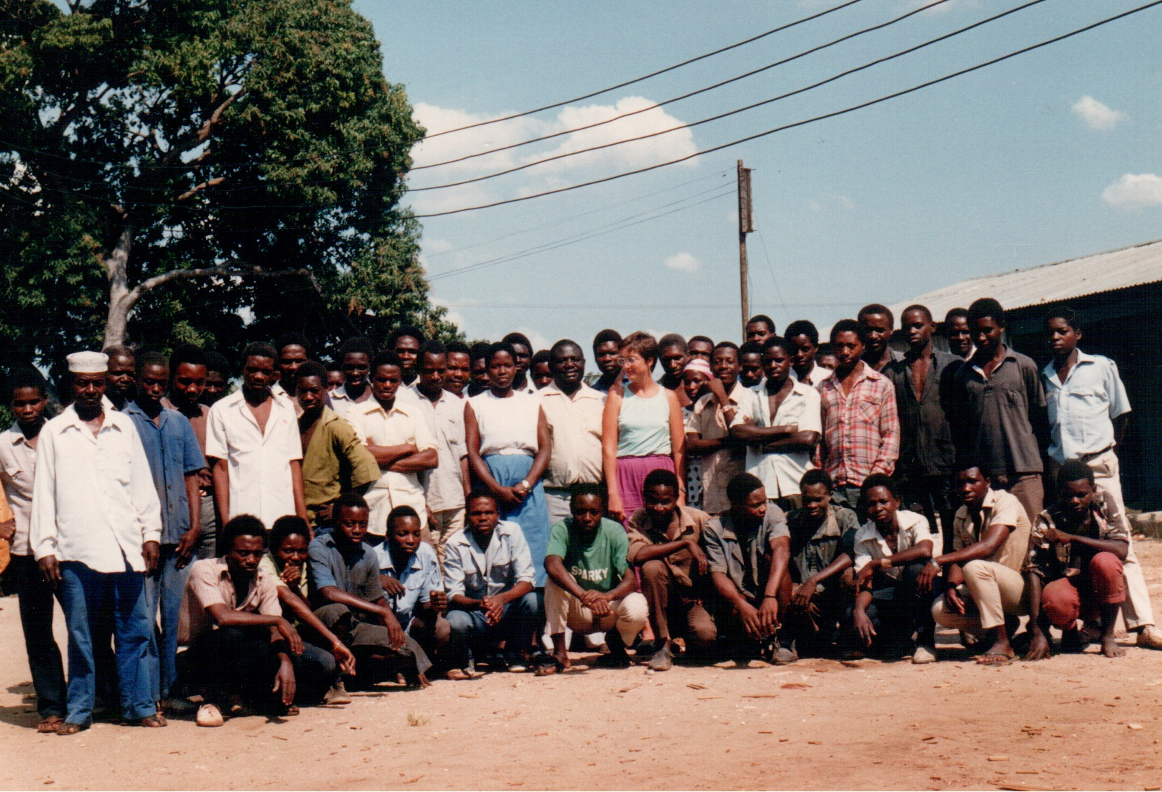
TAMECO knife cooperative Dar es Salaam 1988

Slide 16
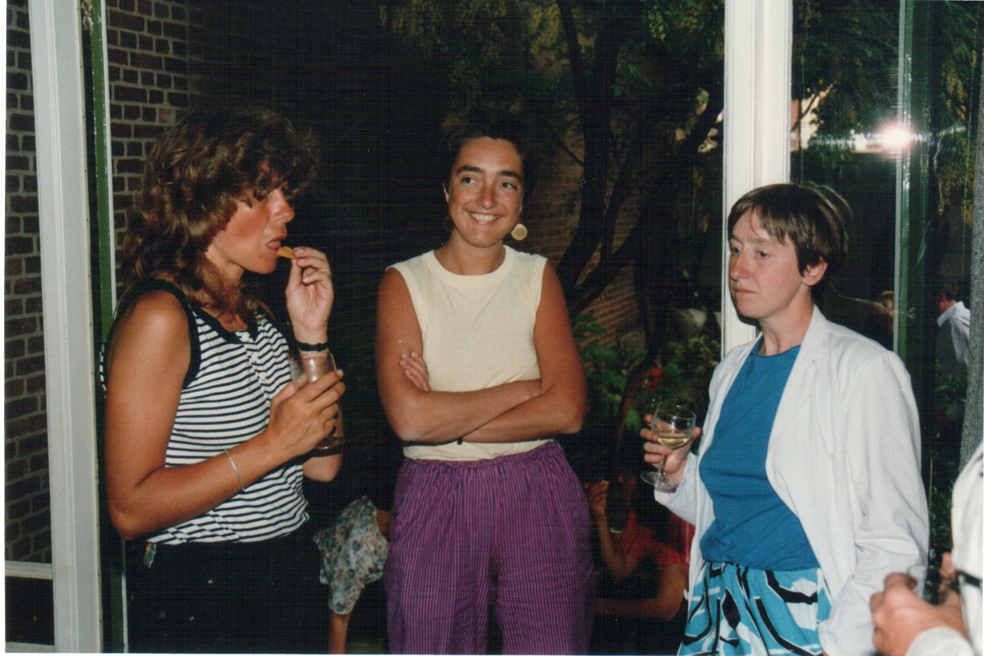
Hivos The Hague1989

Slide 17
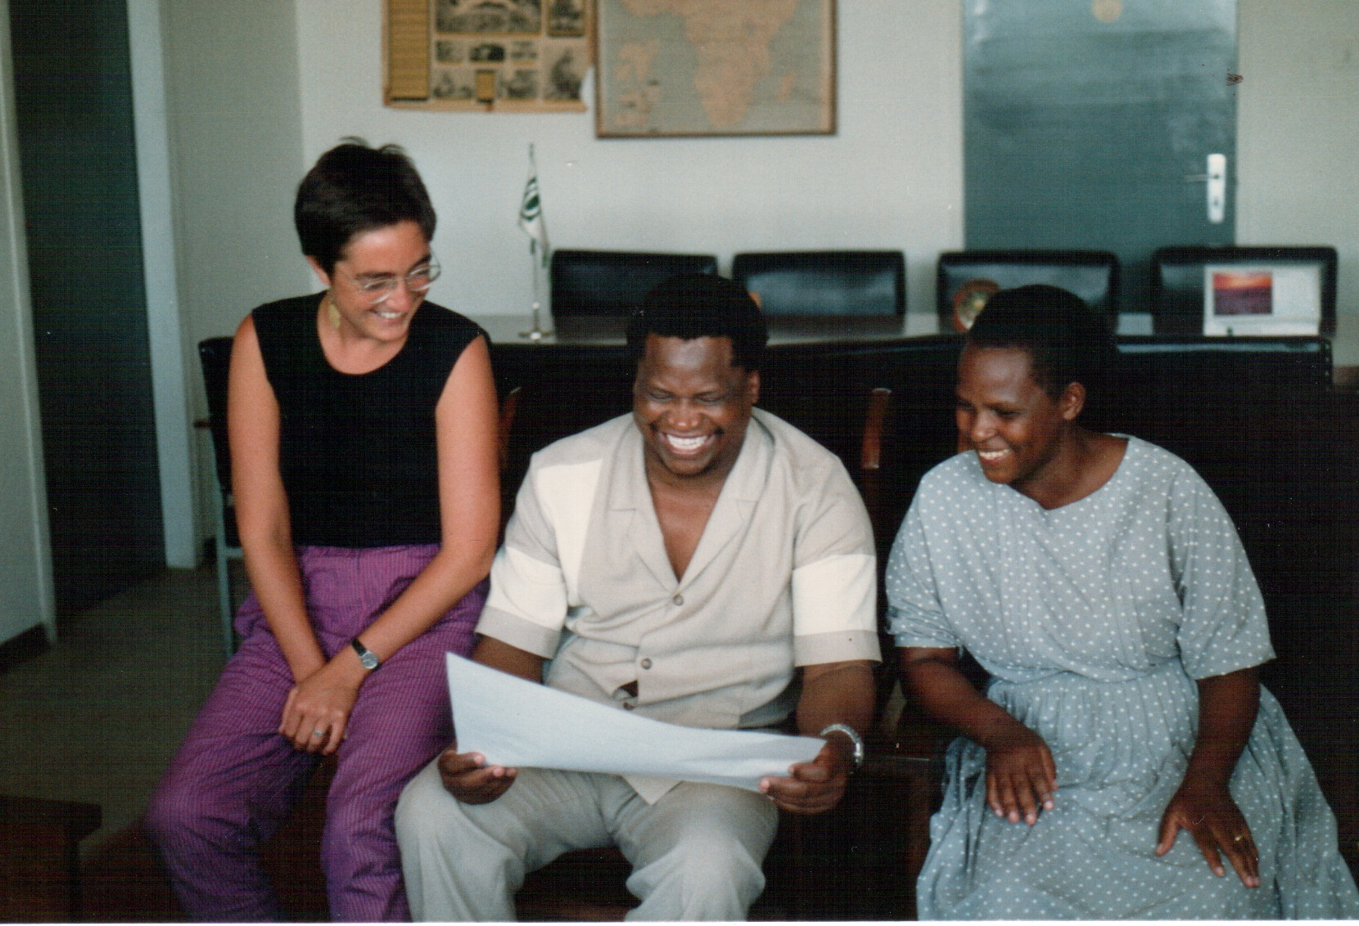
Cooperative Union Tanzania Dar es Salaam 1989

Slide 18
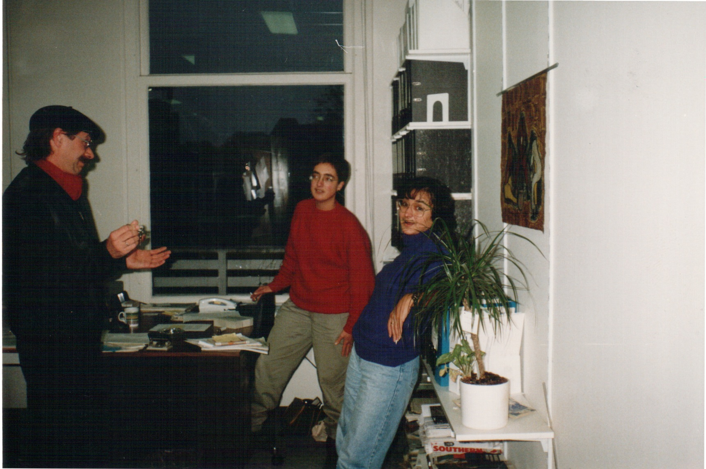
Hivos The Hague1990

Slide 19
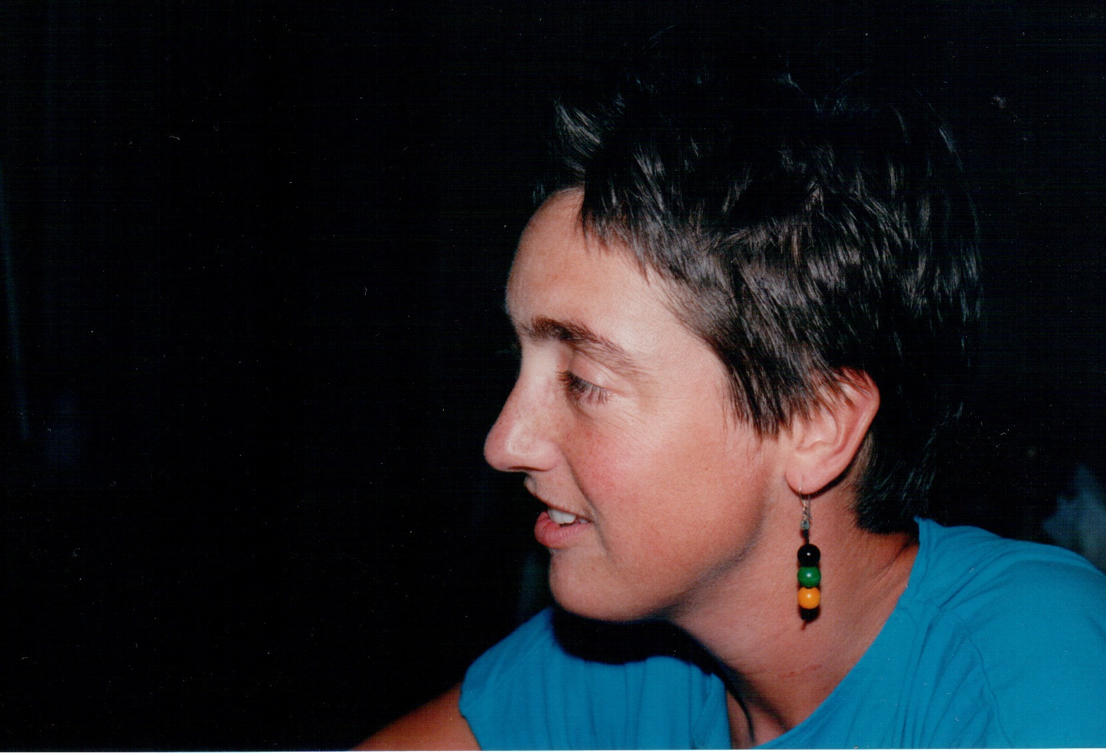
Dar es Salaam 1990

Slide 20
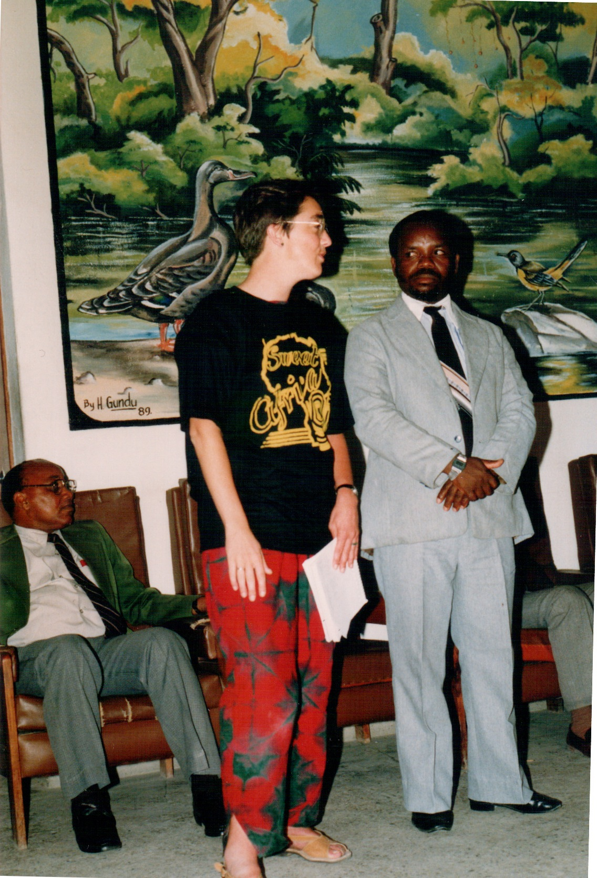
Dodoma1990

Slide 21
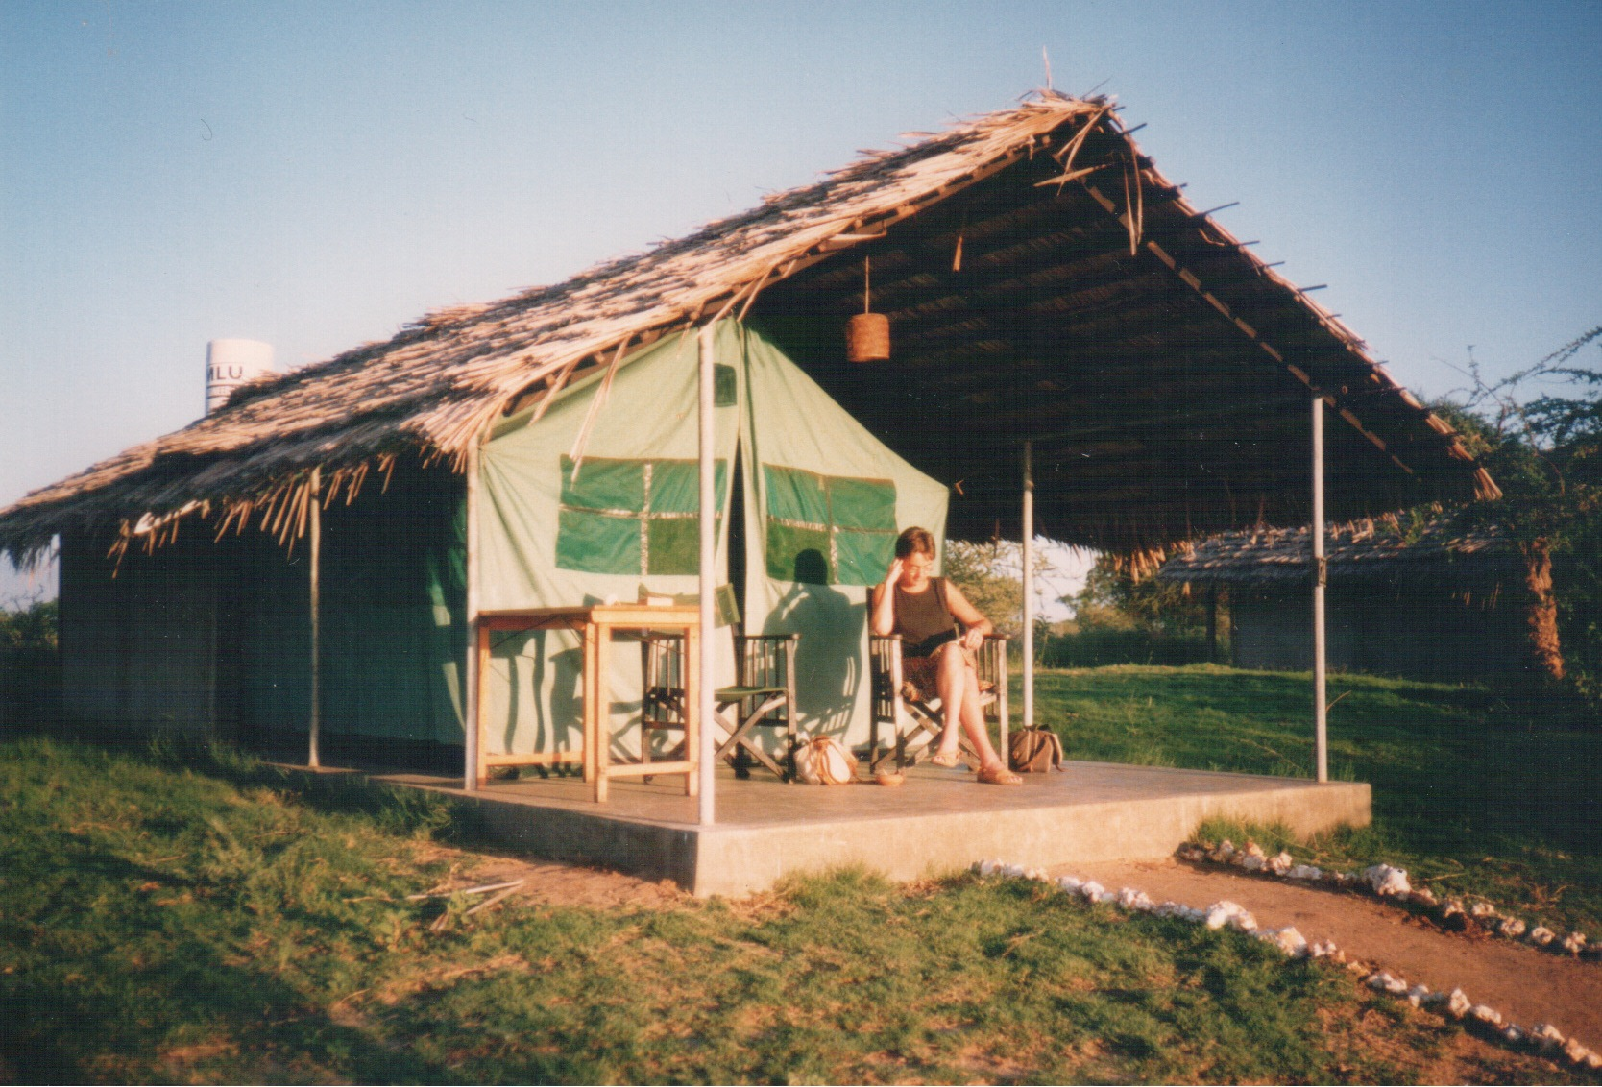
Tanzania1990

Slide 22
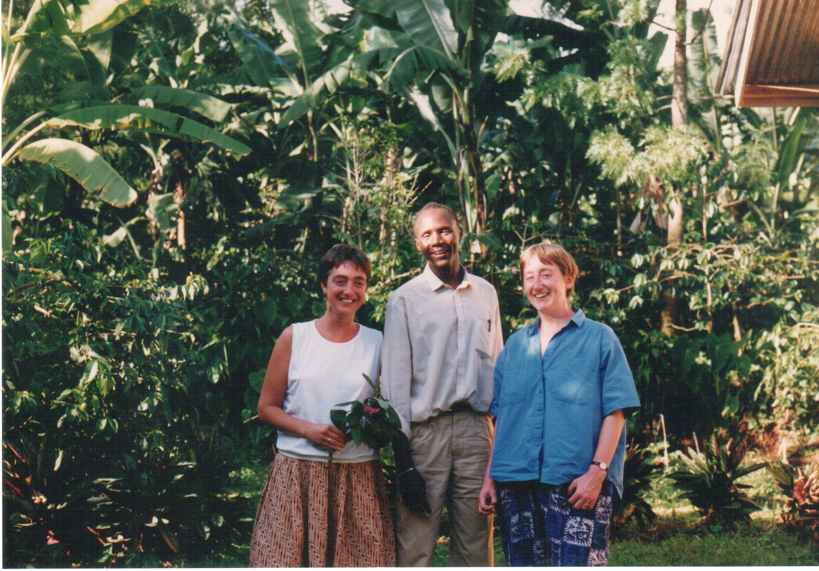
Mount Kilimanjaro 1990

Slide 23
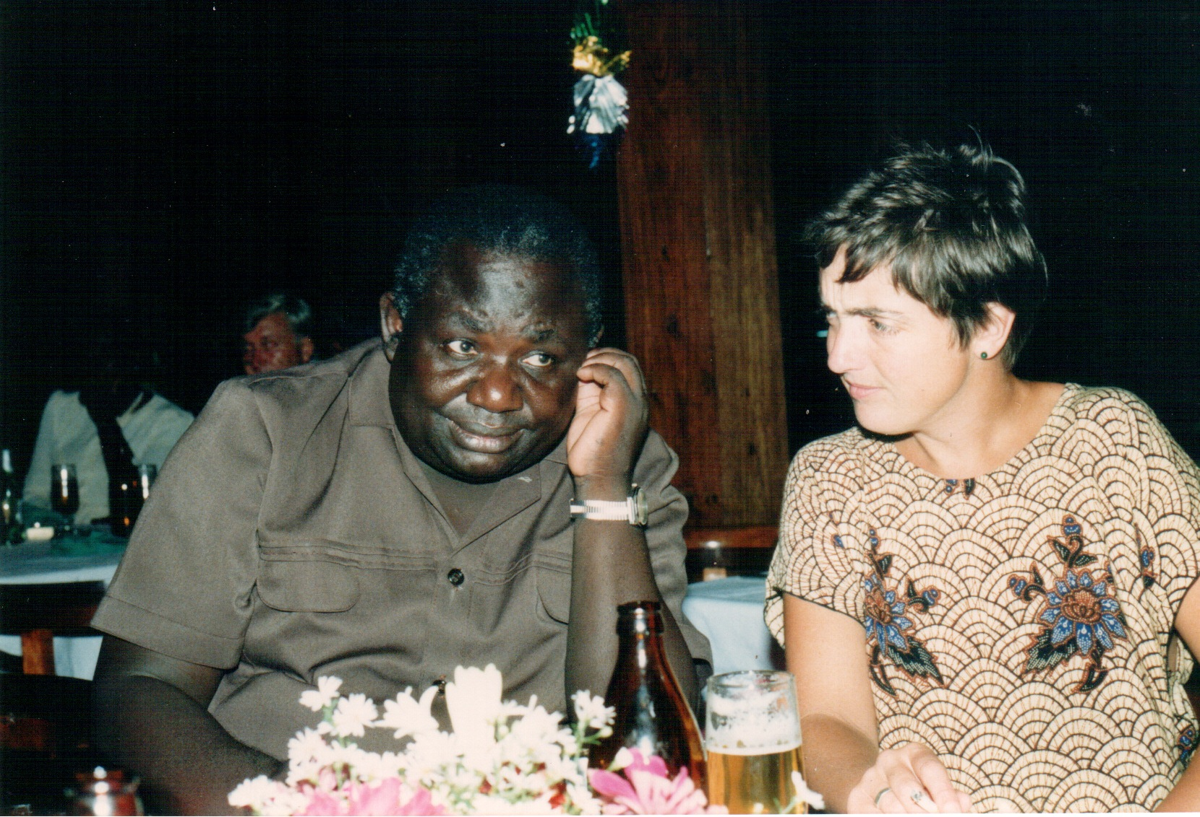
TAMECO Dar es Salaam 1990

Slide 24
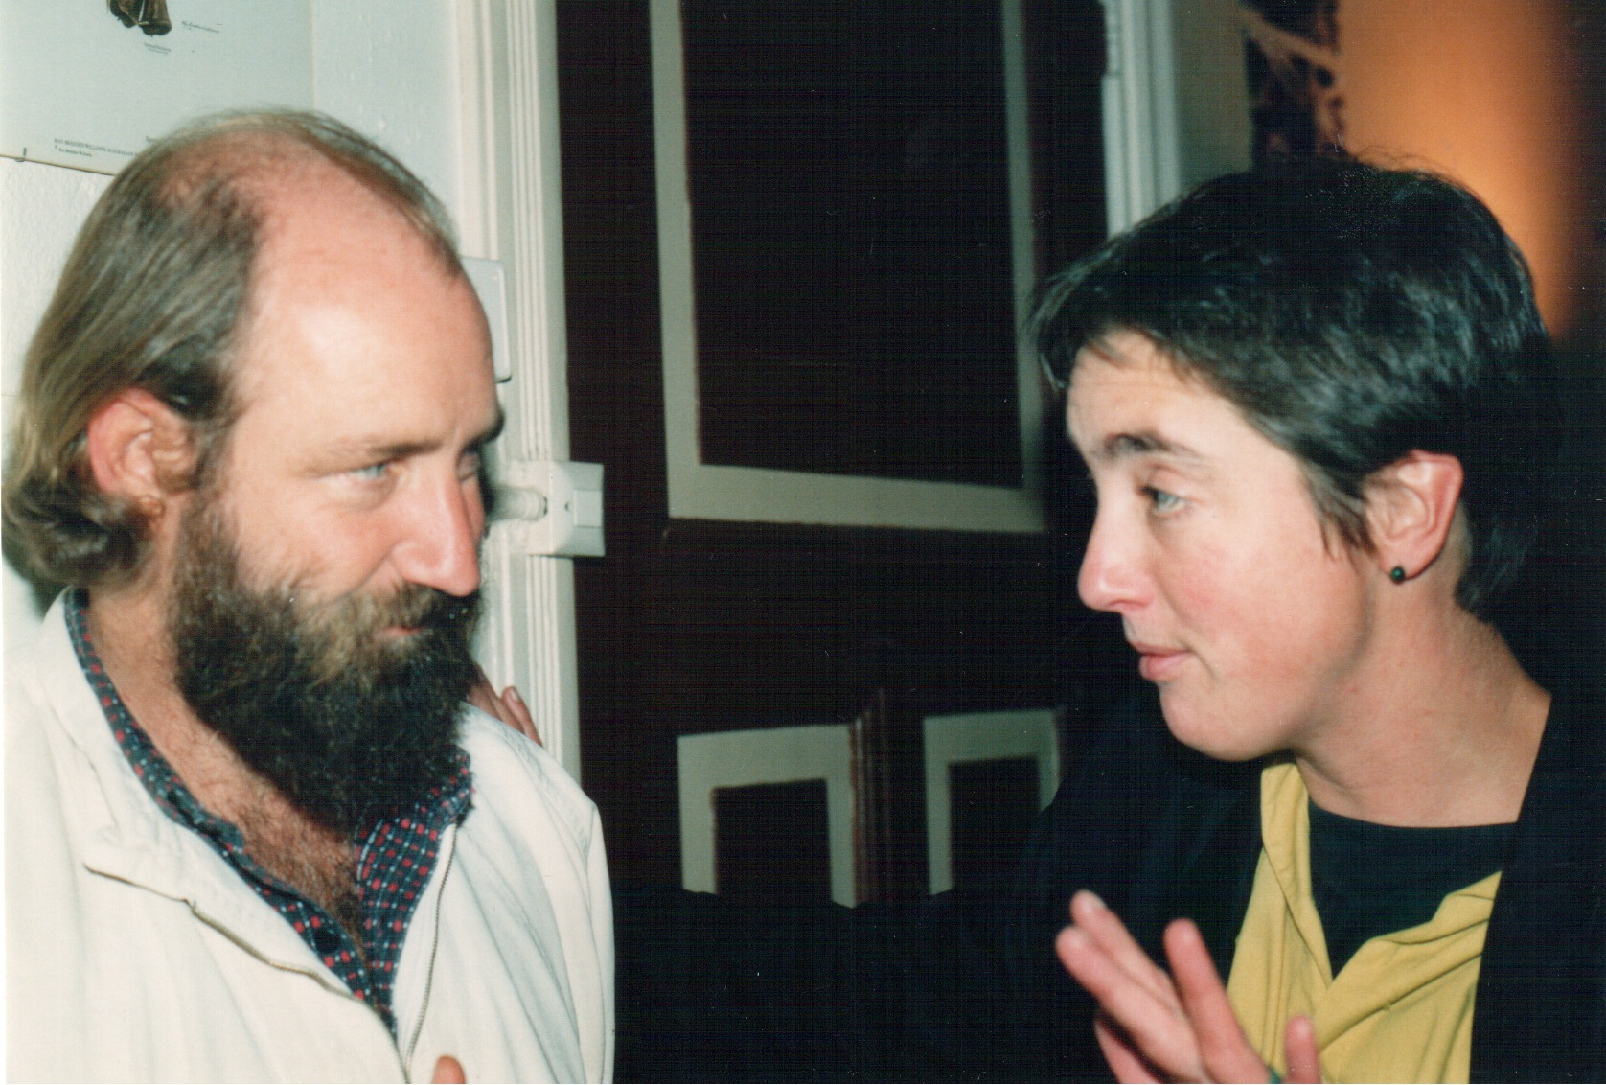
Hivos The Hague 1991

Slide 25
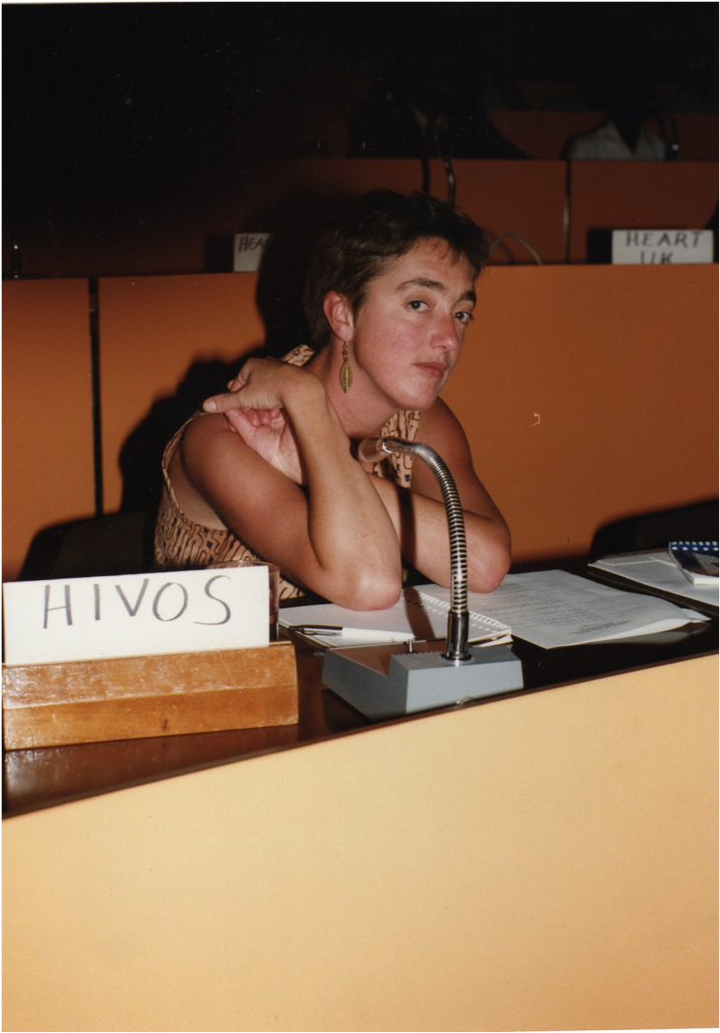
Last ANC conference in exile Arusha 1991

Slide 26
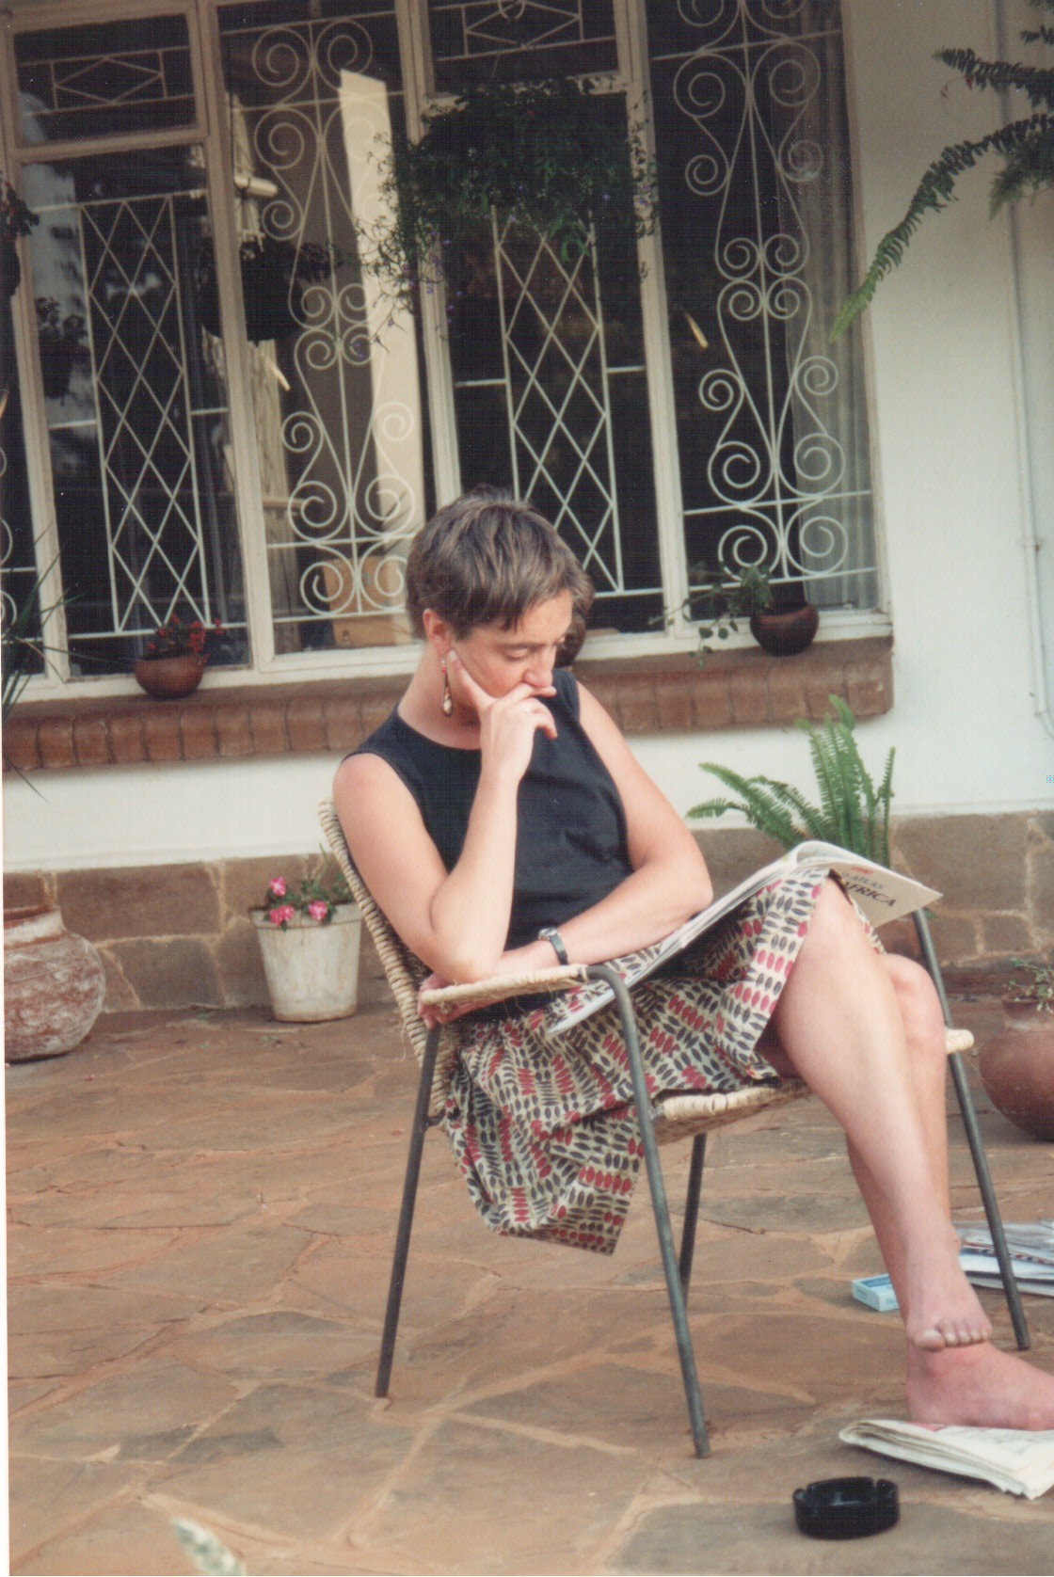
At home in Harare 1991

Slide 27
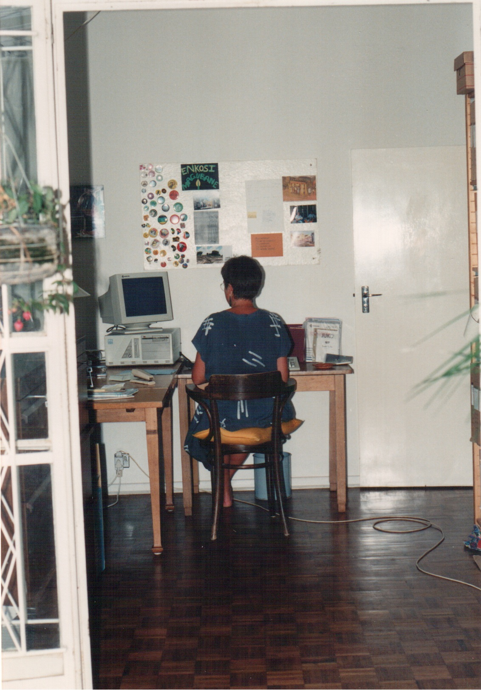
At home in Harare 1991

Slide 28
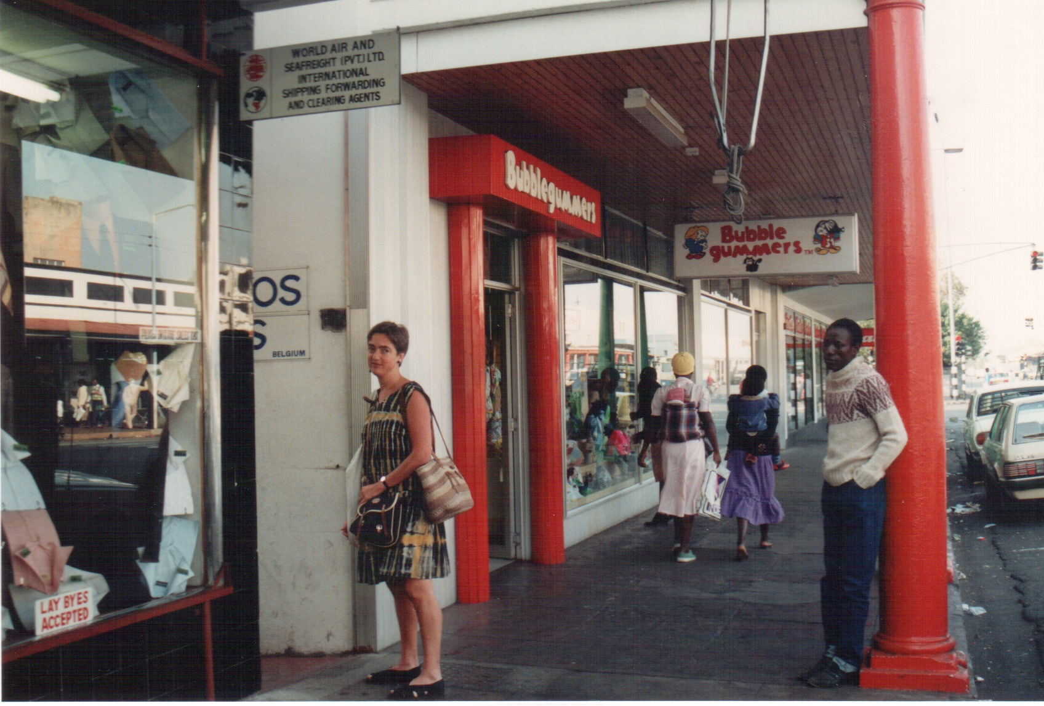
Hivos Office Harare 1991

Slide 29
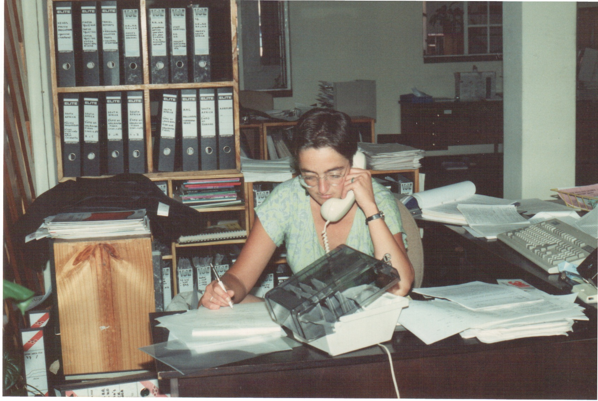
Hivos Office Harare 1991

Slide 30
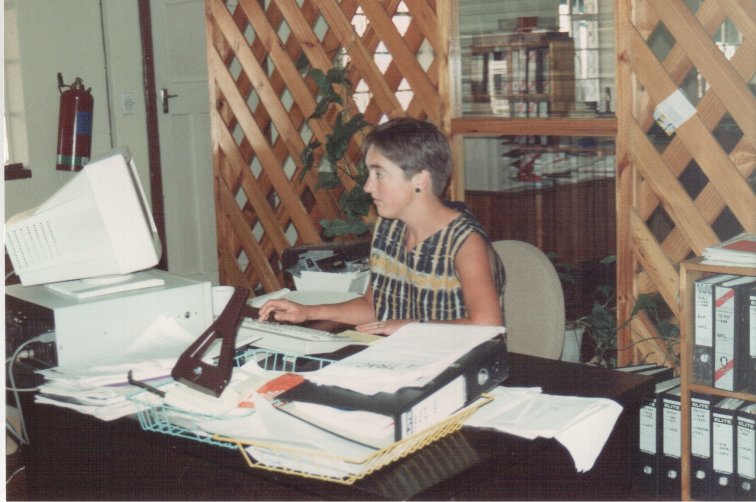
Hivos Office Harare 1991

Slide 31
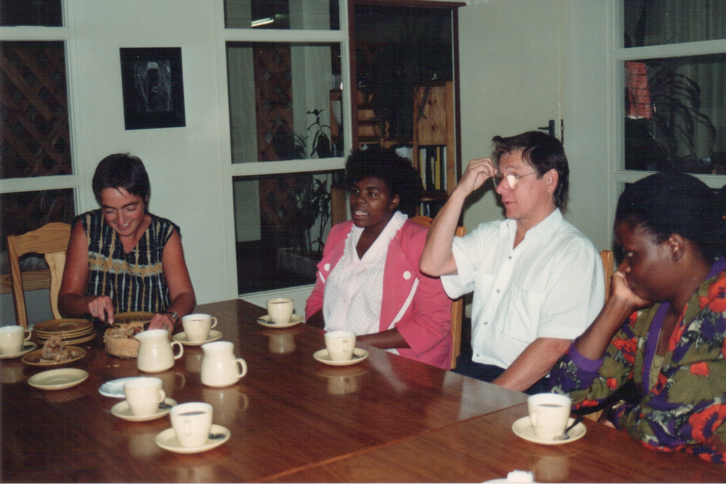
Hivos Office Harare 1991

Slide 32
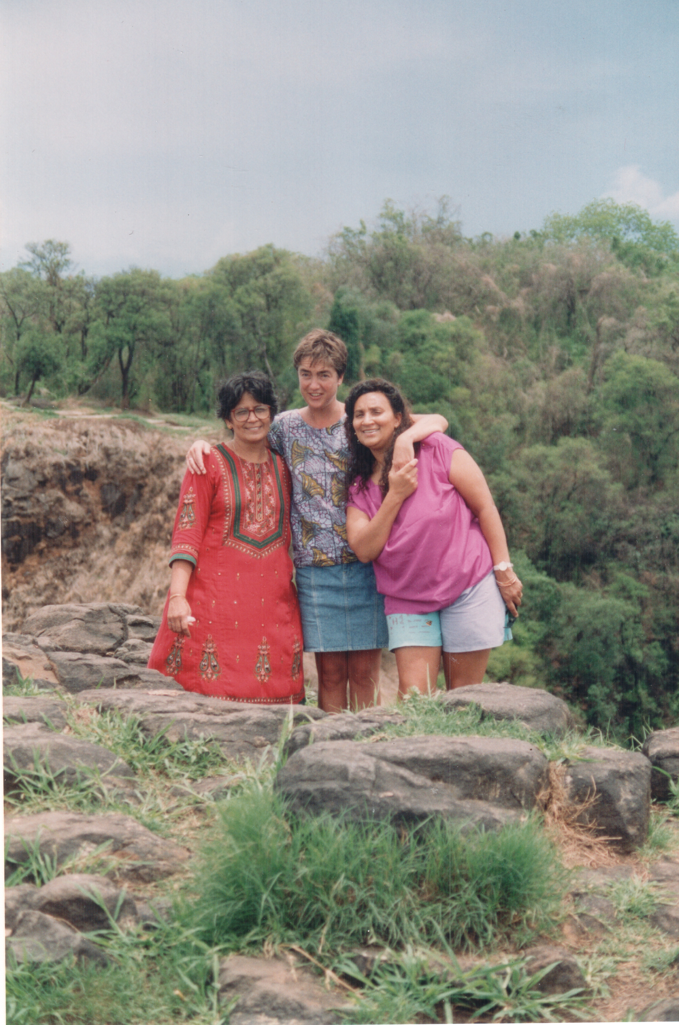
ISS friends at Victoria Falls 1992

Slide 33
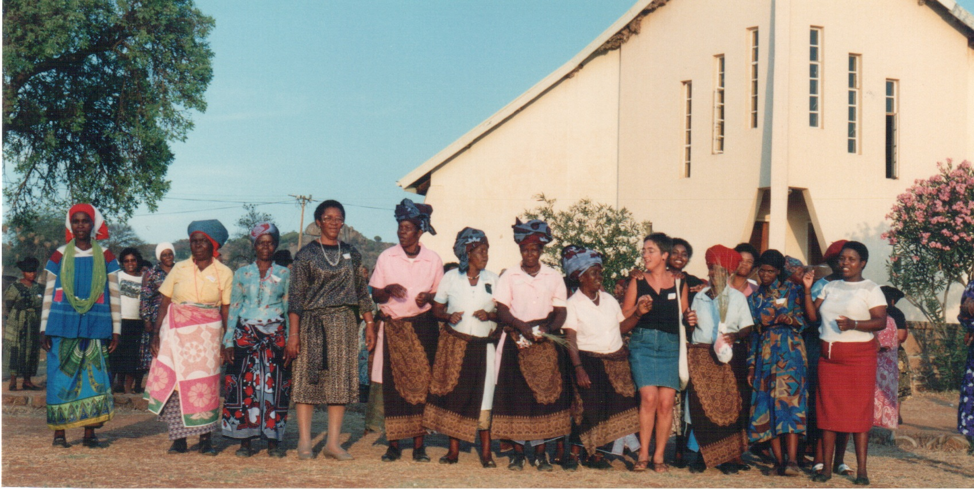
Rural Women’s Movement workshop Northern Transvaal 1992

Slide 34
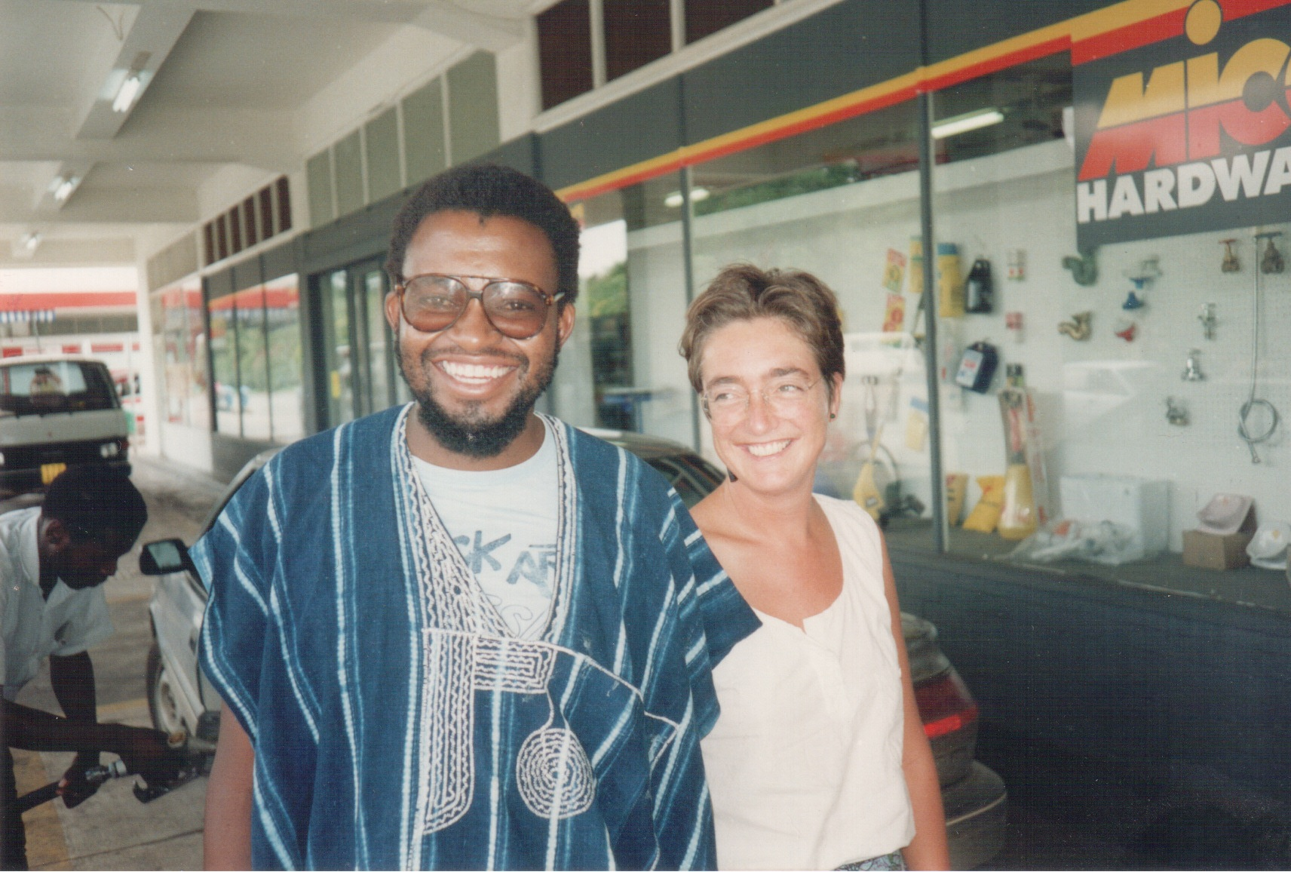
South Africa 1992

Slide 35
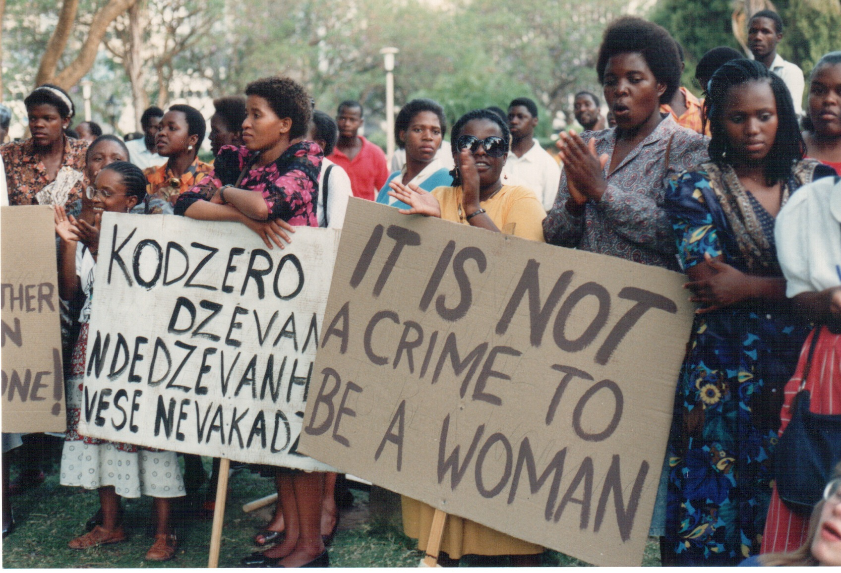
Violence against Women demonstration Harare 1992

Slide 36
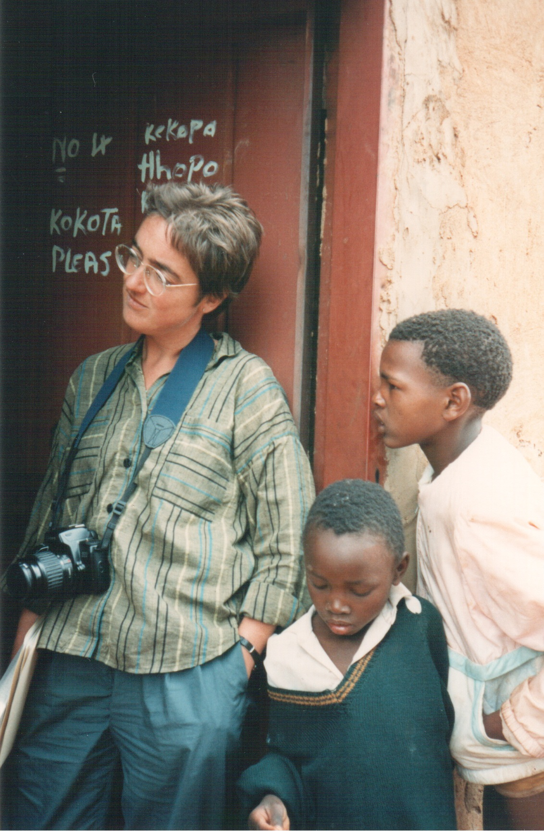
Forced removed community Northern Transvaal 1993

Slide 37
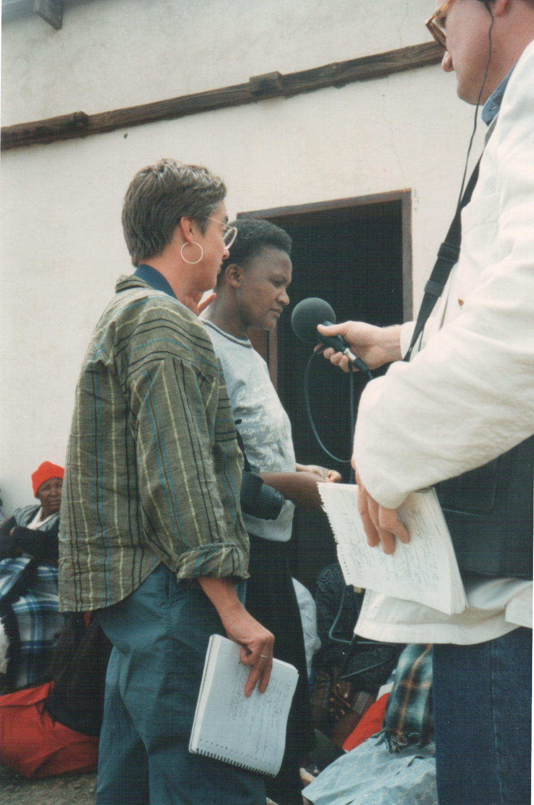
Forced removed community Northern Transvaal 1993

Slide 38
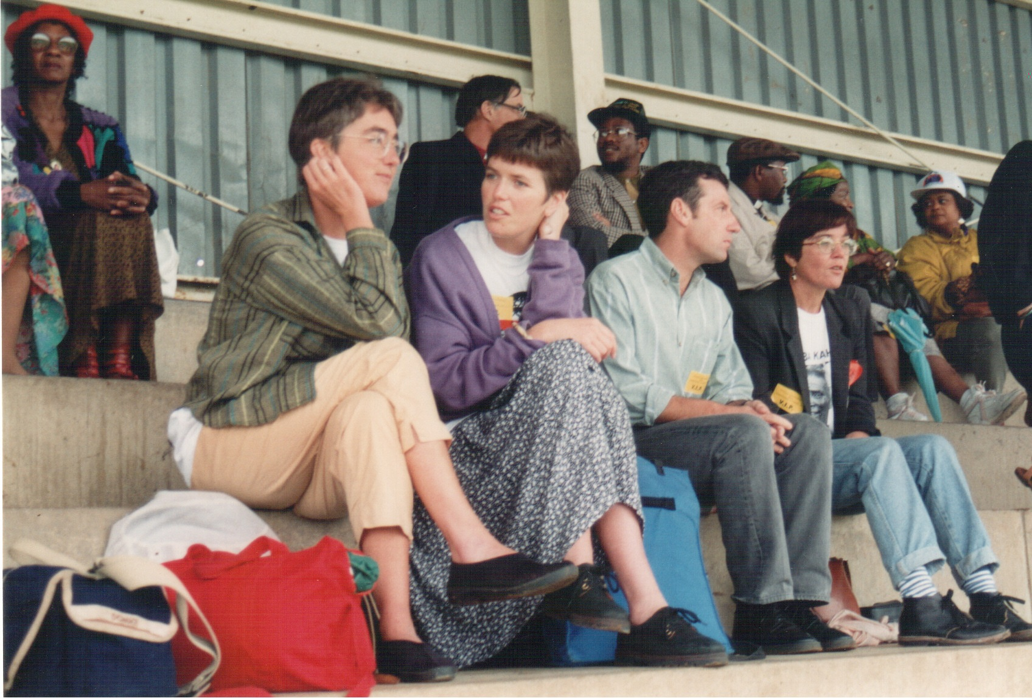
Land rights rally Bloemfontein 1994

Slide 39
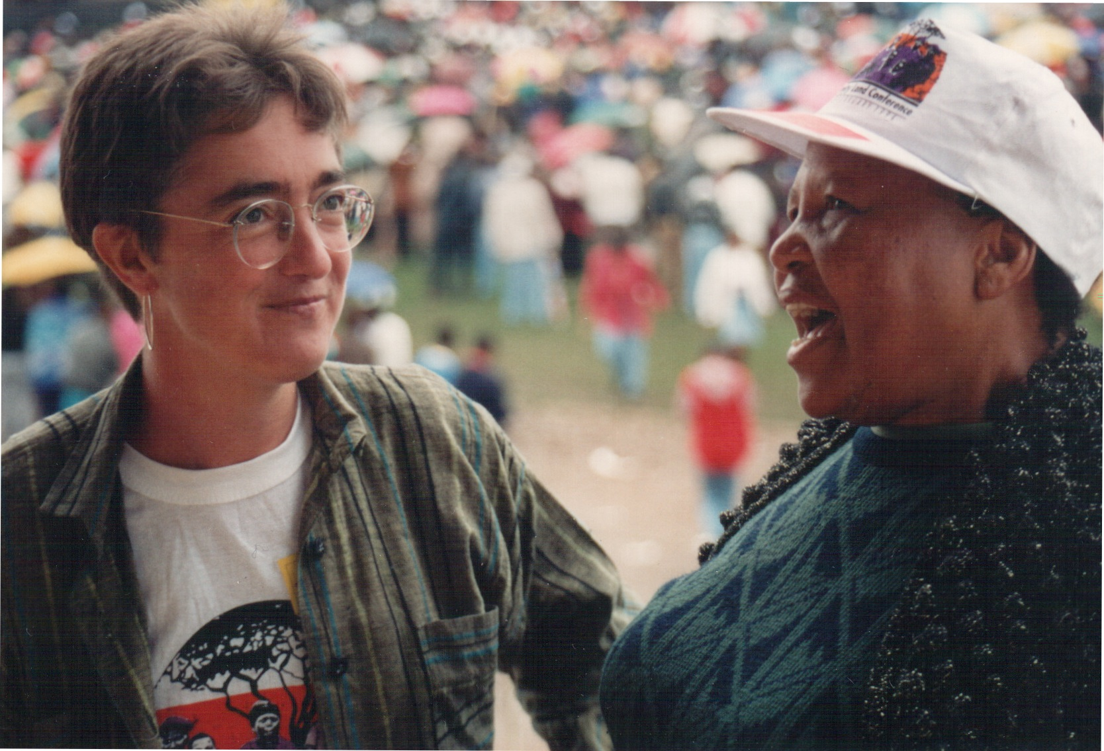
Land rights rally Bloemfontein 1994

Slide 40
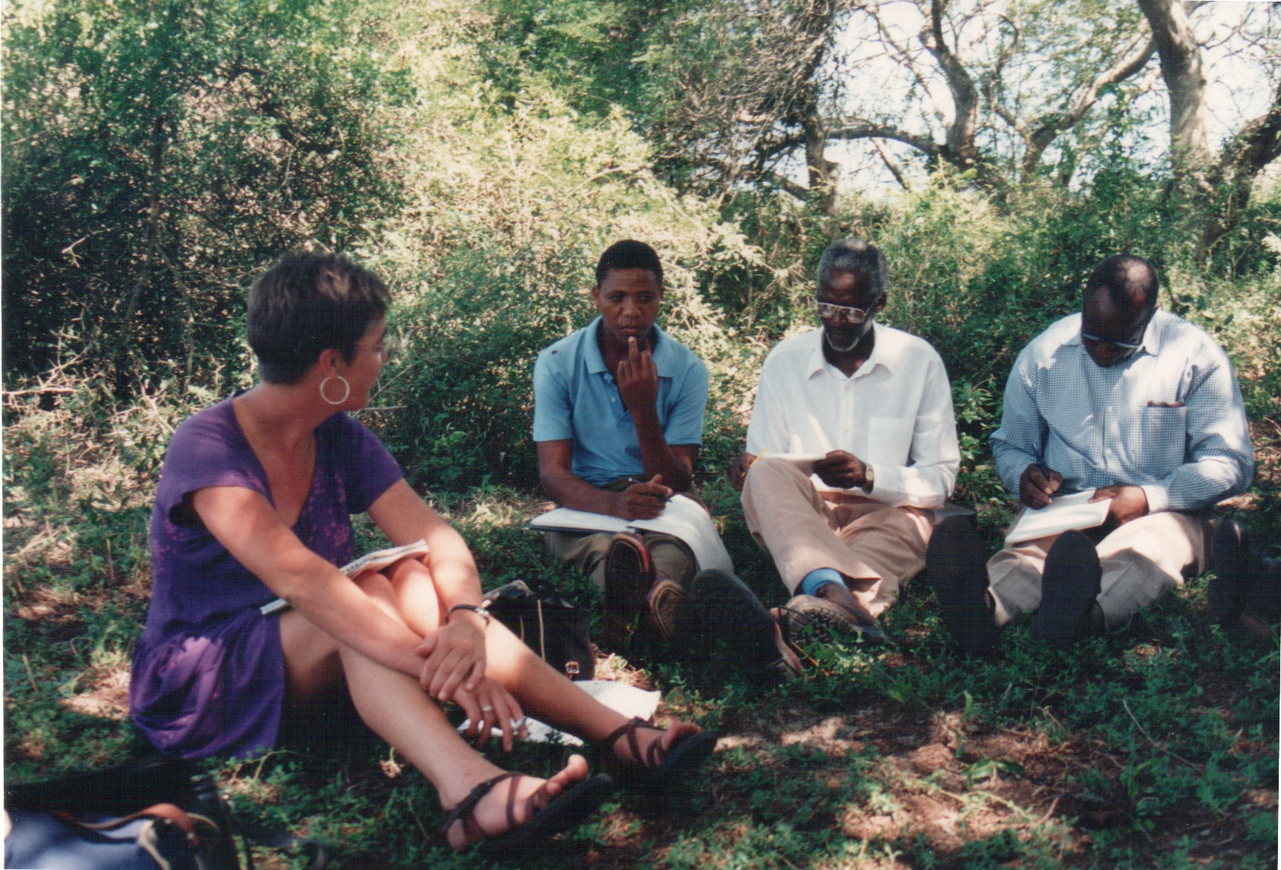
Nguni cattle cooperative Maputaland South Africa 1994

Slide 41
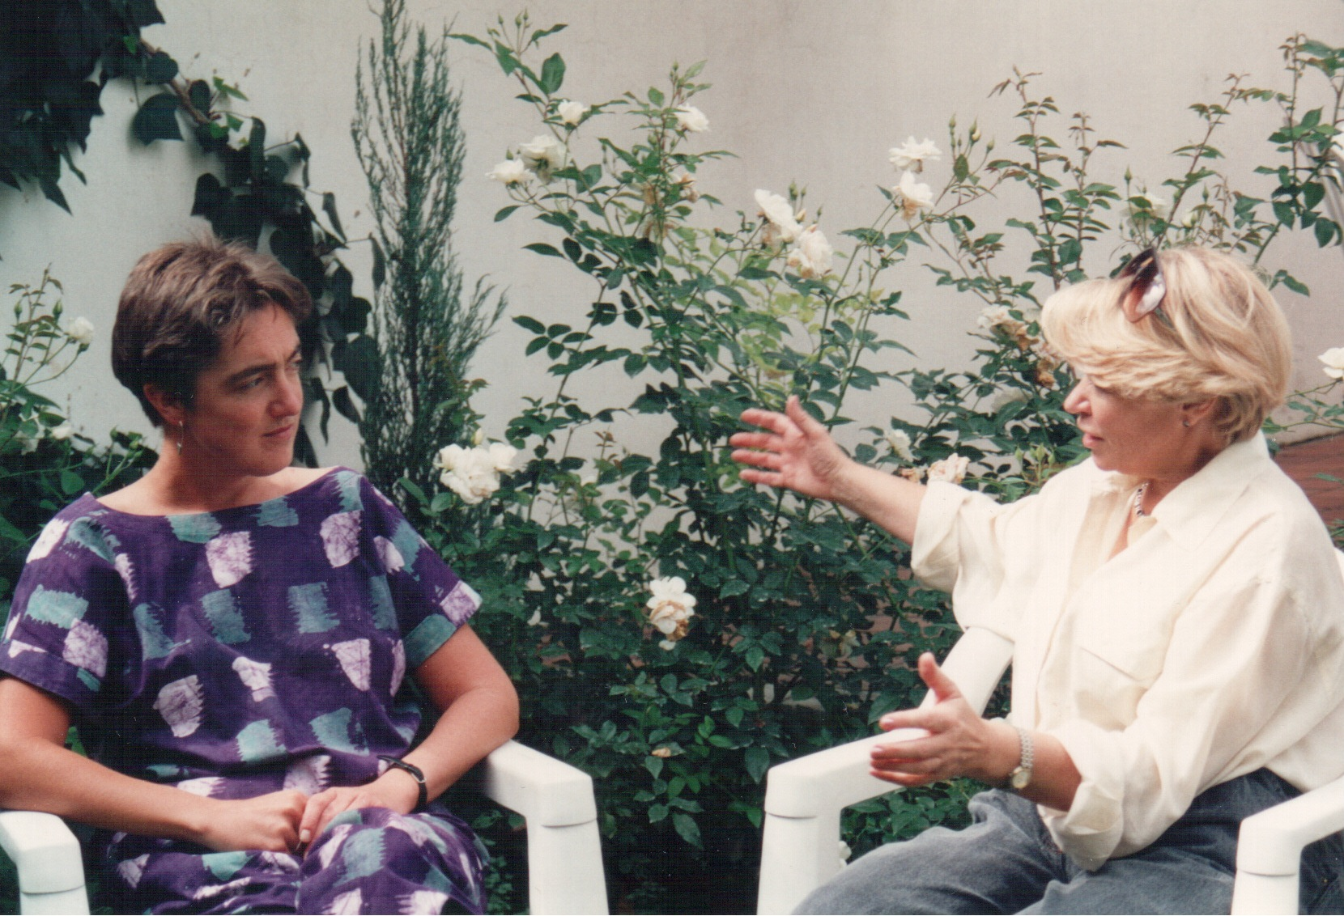
Johannesburg 1994

Slide 42
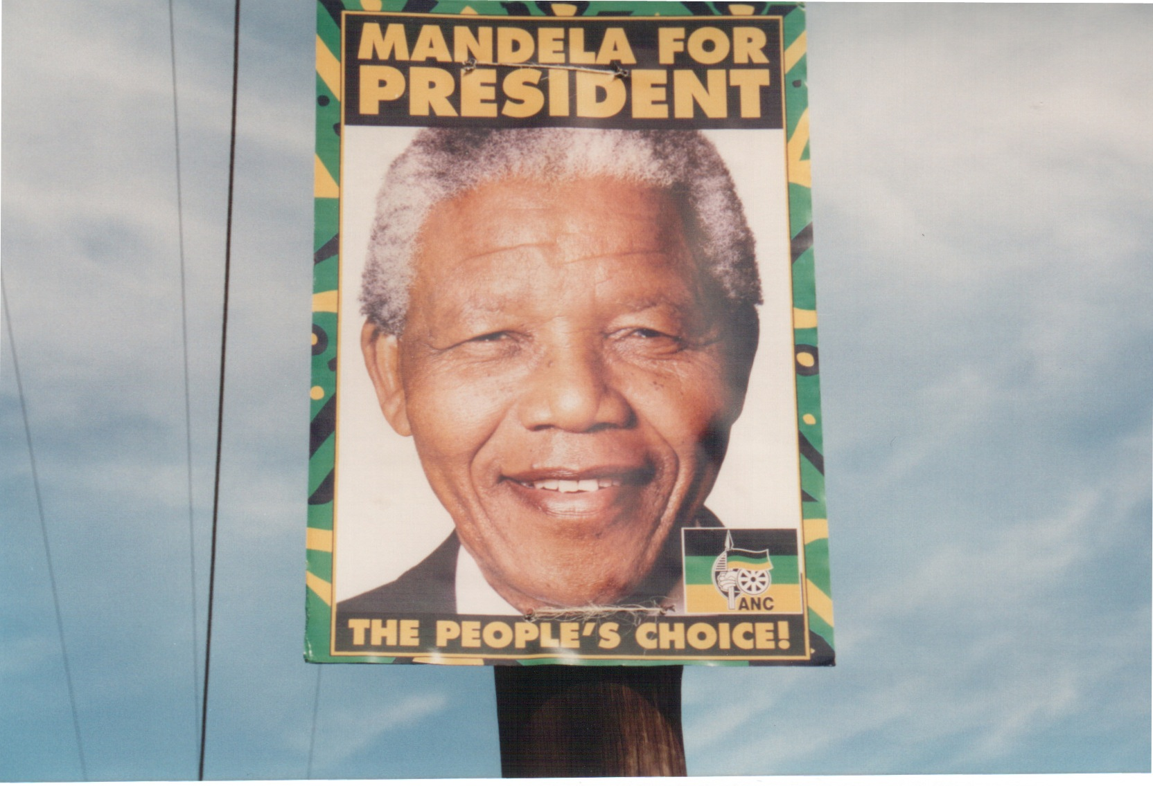
South Africa April 1994

Slide 43
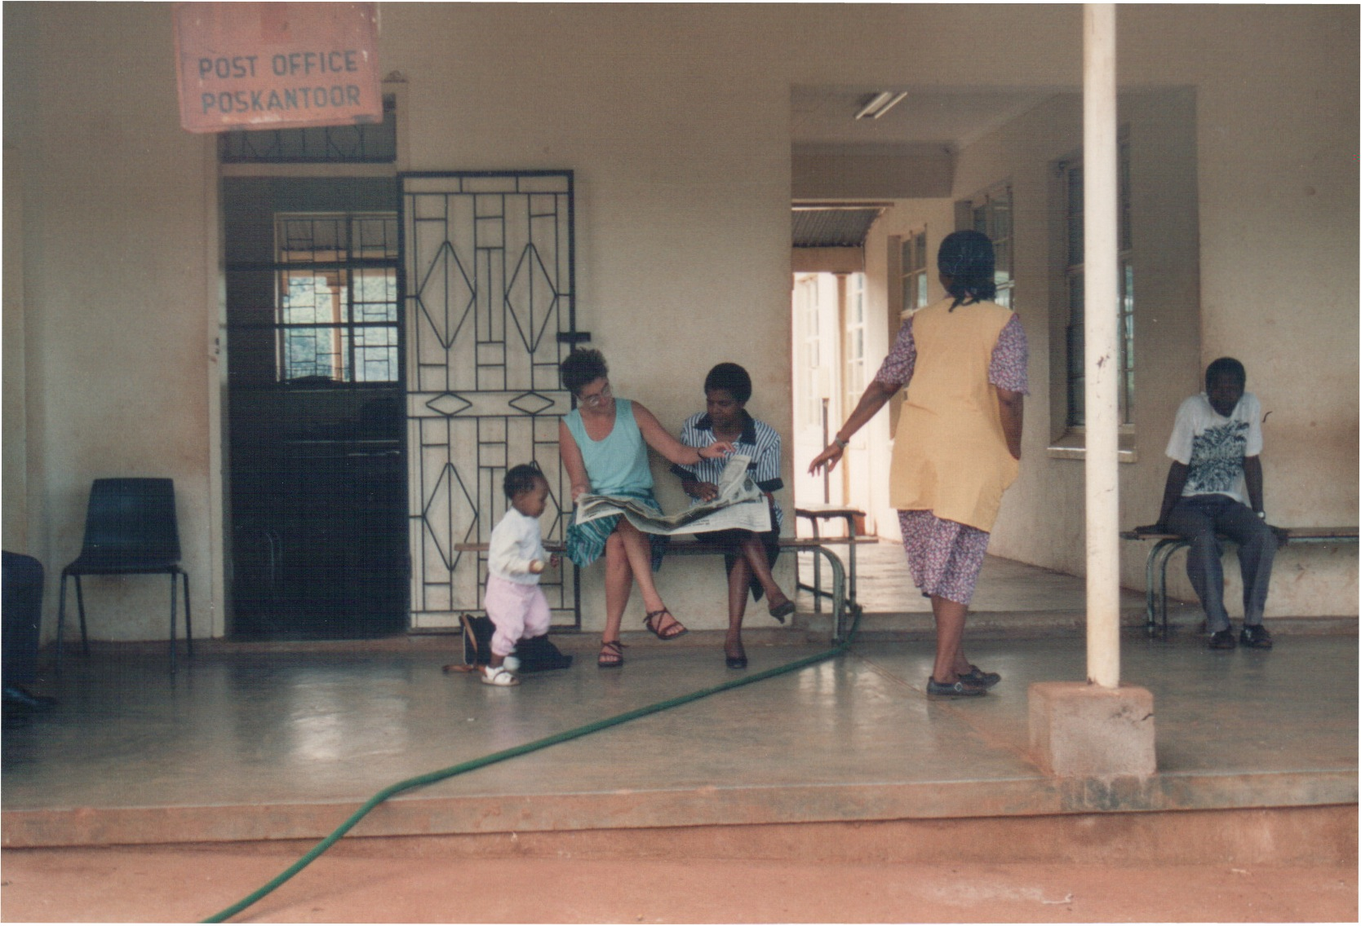
Lebowa South Africa 1994

Slide 44
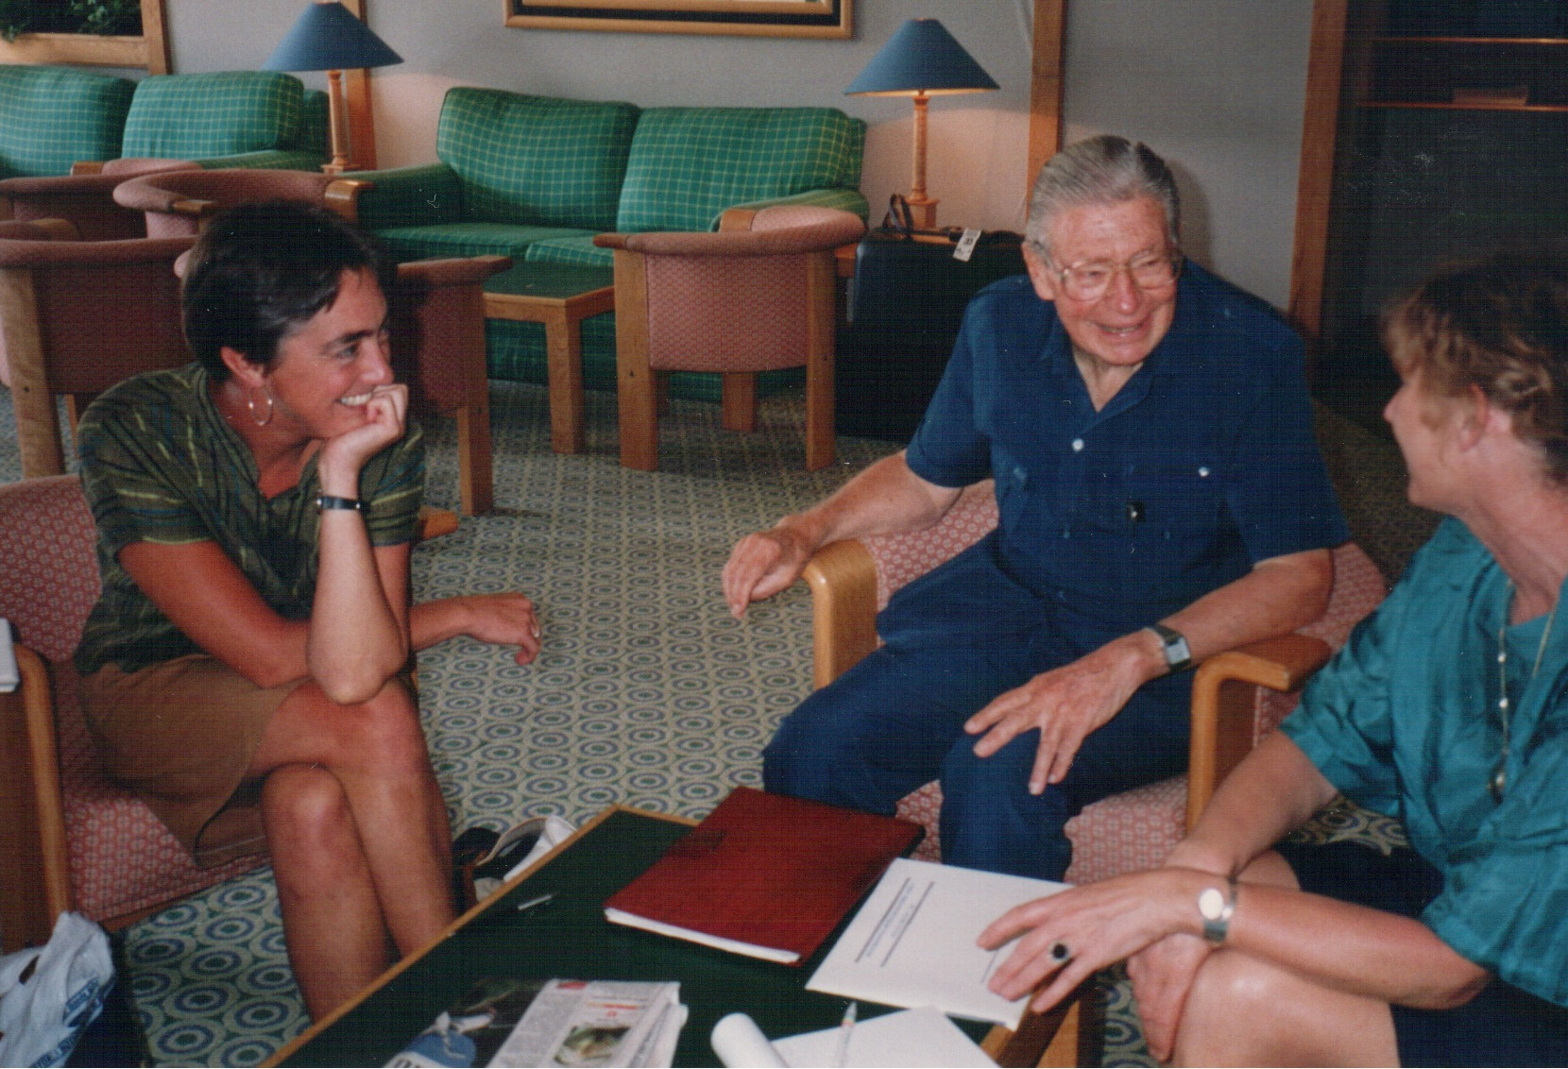
Johannesburg 1994

Slide 45
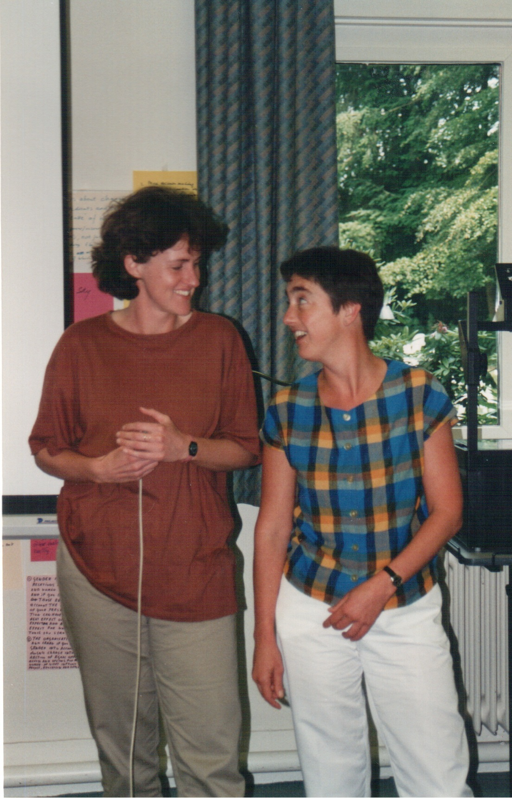
Netherlands 1995

Slide 46
Zimbabwe International Book Fair Harare 1995

Slide 47
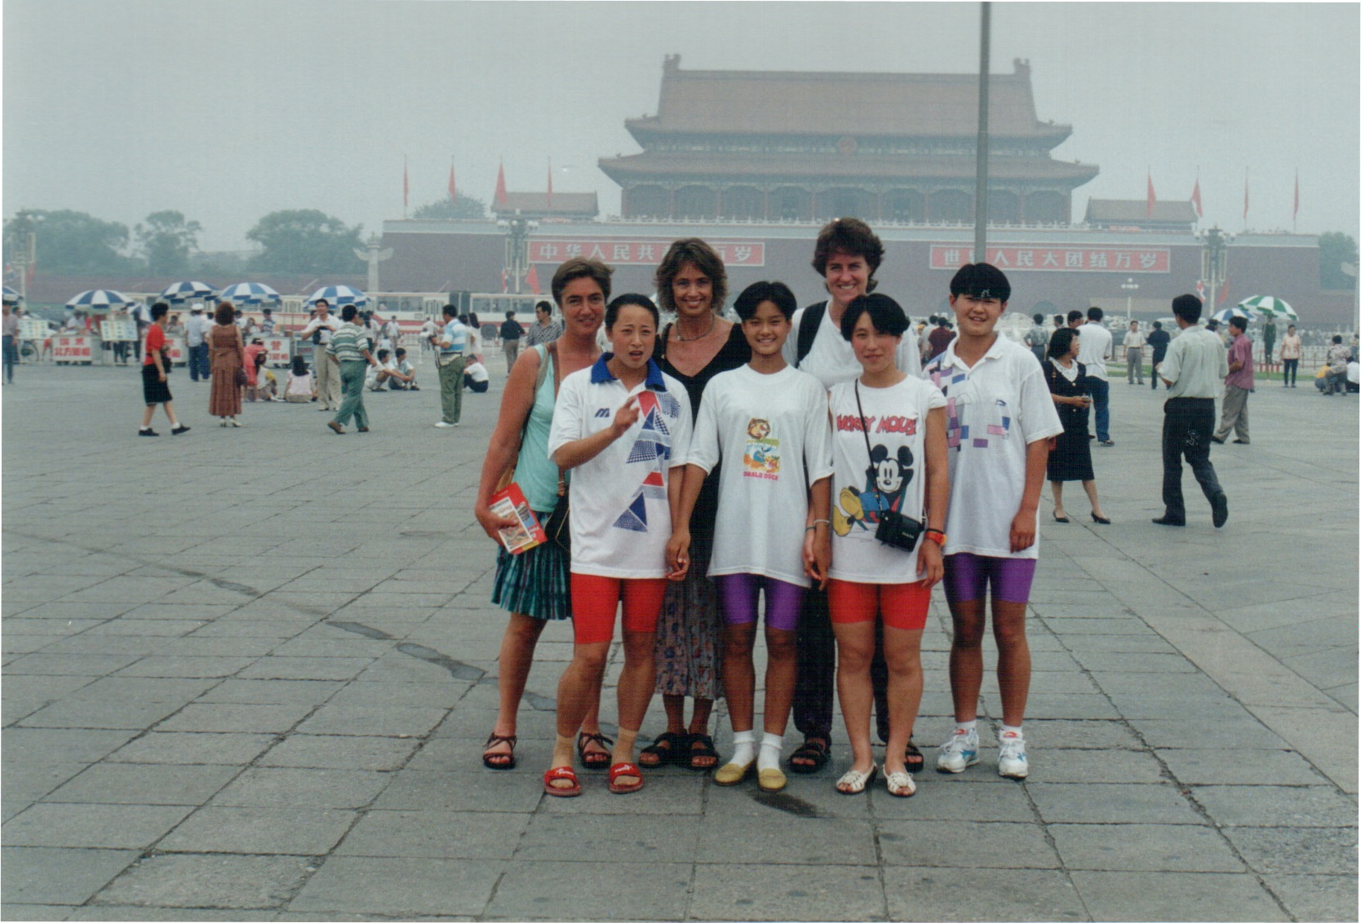
Beijing1995

Slide 48
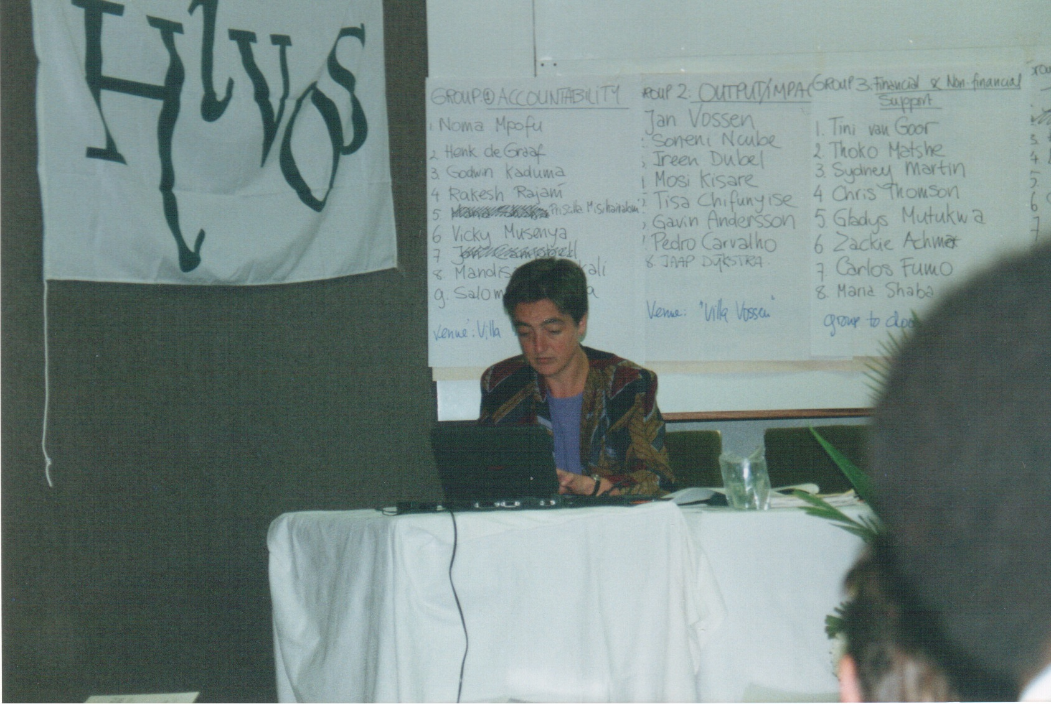
Hivos Africa partner consultation workshop Zimbabwe 1996

Slide 49
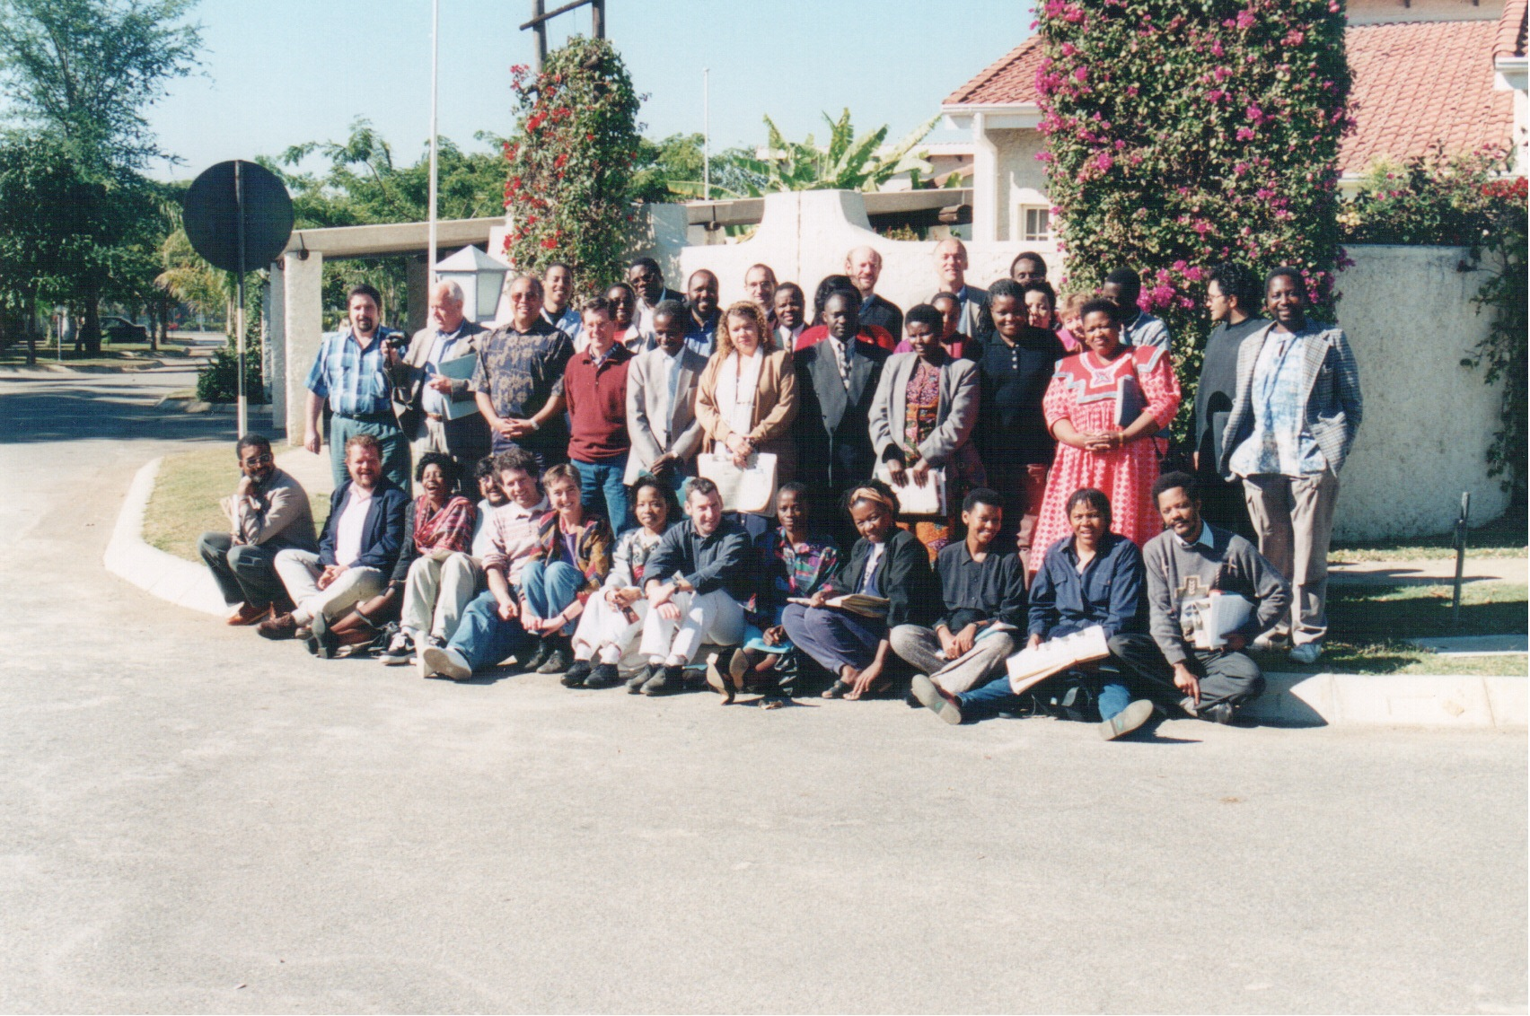
Hivos Africa partner consultation workshop Zimbabwe 1996

Slide 50
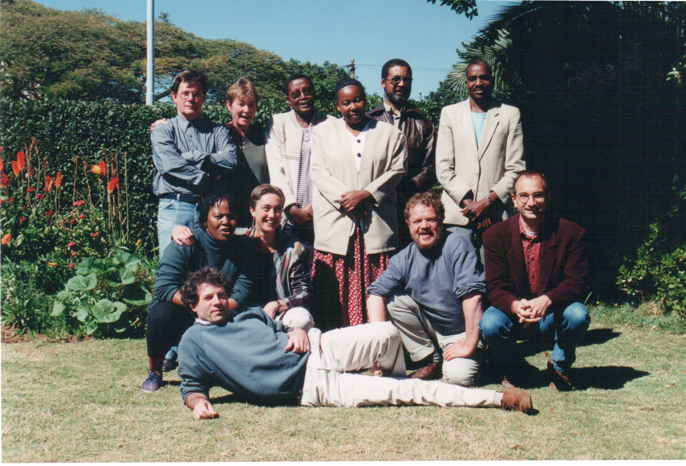
Zimbabwe 1996

Slide 51
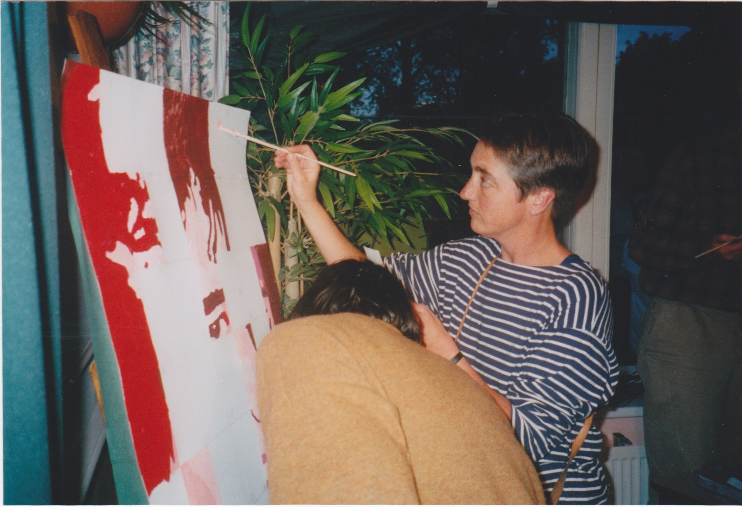
Hivos The Hague1997

Slide 52
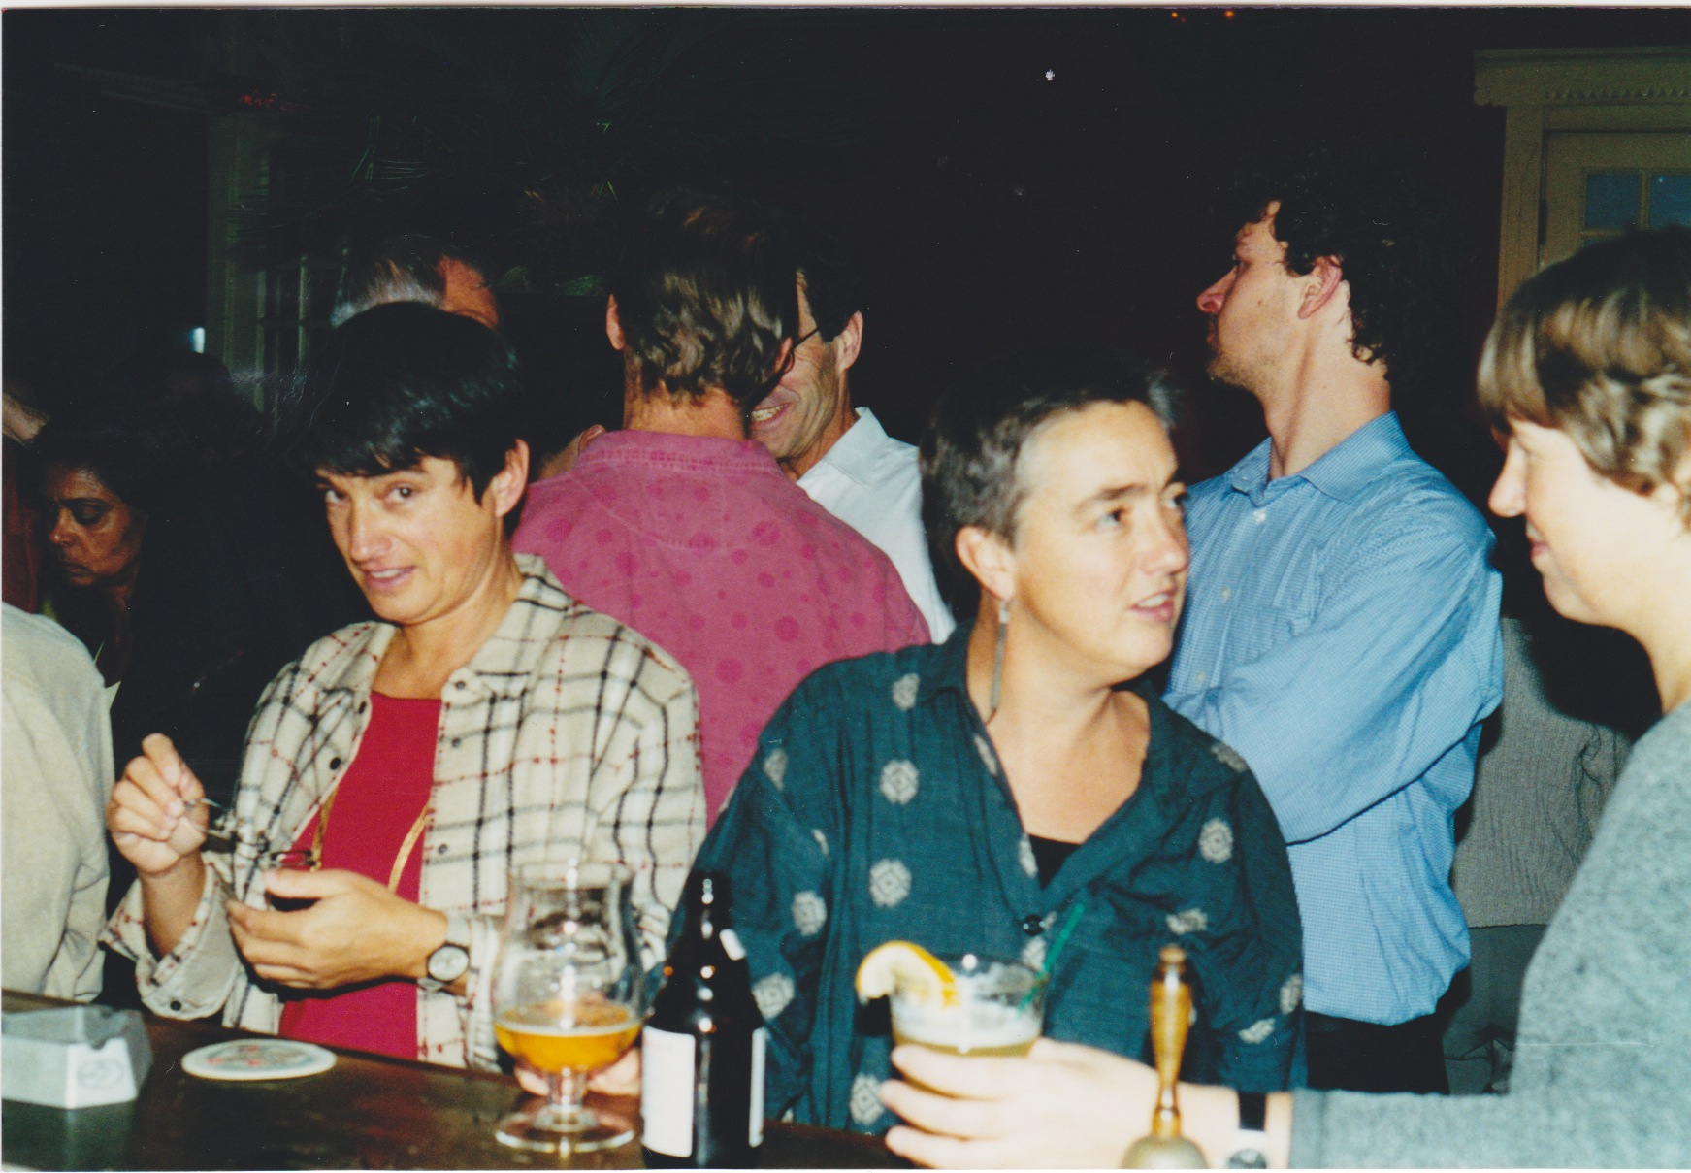
Hivos The Hague1997

Slide 53
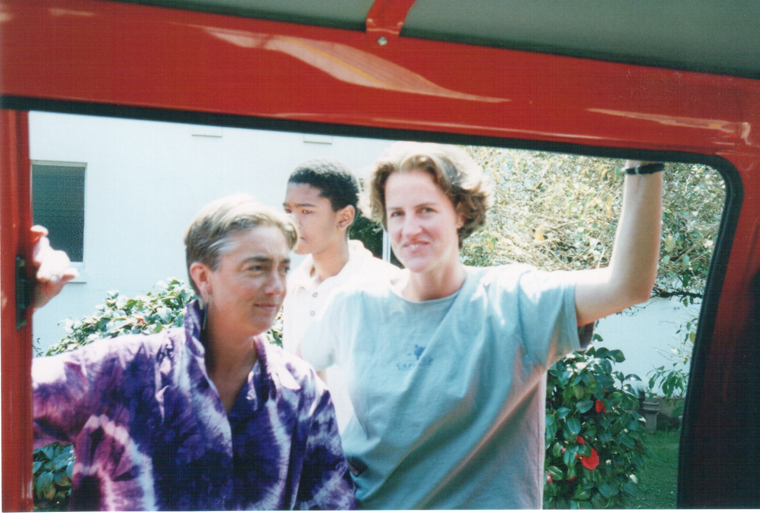
Zimbabwe 1997

Slide 54
Gay Games Amsterdam 1998

